Slide 1
Noncontiguous Clustering
New Jersey’s New & Improved Planning Tool
Notes:
We’re here today to discuss the noncontiguous cluster, a new and improved planning tool that municipalities can add to their ordinances as a way to encourage land preservation while promoting attractive growth.

Slide 2
In a nutshell…
Notes:
So, what is noncontiguous clustering? We first should begin by examining the existing land use tools available to municipalities in New Jersey…

Slide 3
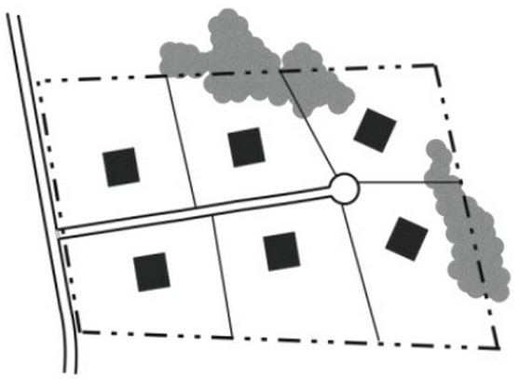
Conventional Development
“Large Lot Zoning”
Uniform Lot Sizes
Development covers most, or all, of the site
Notes:
Conventional development is your most basic idea of a subdivision. A developer divides the total parcel of land by the prescribed zoning density for that area to yield a total number of lots, all equal in size. Often, large minimum lot sizes are used in an attempt to limit development impacts. This is sometimes referred to as “large lot zoning.”

Slide 4
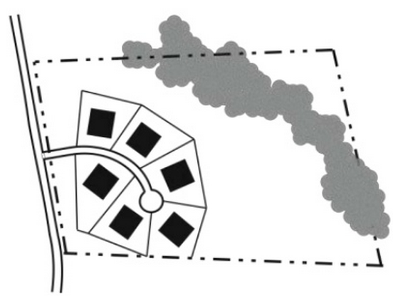
Contiguous Cluster Development
Development is concentrated on a portion of the site
Remaining land is permanently preserved as open space or farmland
Notes:
The contiguous cluster development has been used as a way to permit development while also preserving land for open space or farmland. Number of units is the same or similar to that of a conventional development, but each lot will be smaller in size. This permanently preserves land or open space without public funding.

Slide 5
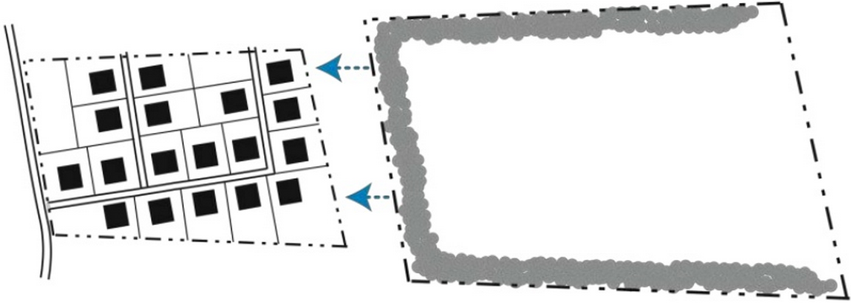
Noncontiguous Cluster Development
Two or more non-adjacent parcels are treated as a single site for the purpose of clustering.
Notes:
Basically: The noncontiguous cluster development is similar to that of the cluster development, but instead of one site where development is clustered and the rest of the land is preserved, development is clustered on one or more parcels and another (or multiple parcels) is permanently preserved.

Slide 6
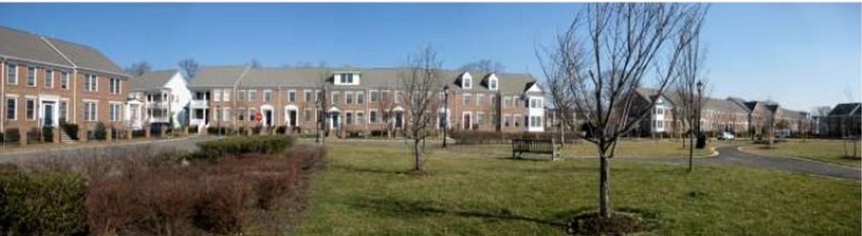
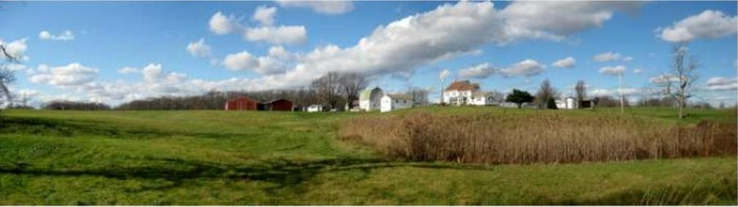
What does it do?
Puts development where it makes the most sense
Achieves preservation using private funds
Notes:
Simply put, the noncontiguous cluster helps direct development where it makes the most sense, while permanently preserving farmland, open spaces or historic sites with fewer public dollars than conventional preservation.

Slide 7

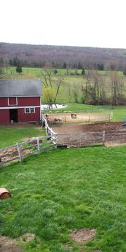
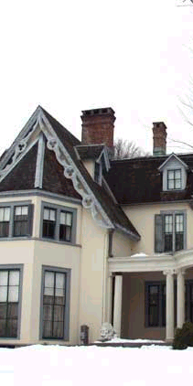
What can it be used to preserve?
Notes:
Noncontiguous clustering can be used for open space preservation, farmland preservation or even the protection of historic sites or structures.

Slide 8
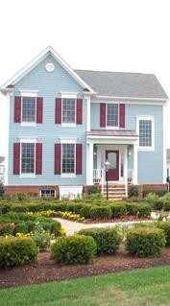
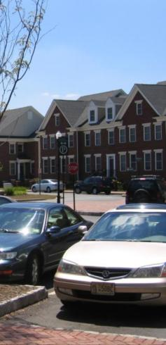
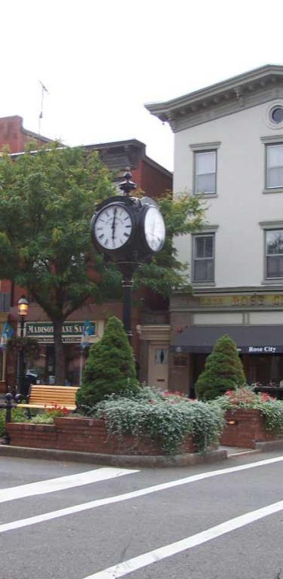
What types of growth can occur?
Notes:
Growth can include residential, mixed use areas, as well as non-residential development. Growth areas can be located in rural communities, small towns, suburban areas, and urban areas.

Slide 9
How does noncontiguous clustering work?
Municipality designates areas that are eligible for growth and preservation under noncontiguous cluster.
Permissive! Underlying zoning remains in place, so landowners have the option to participate
“Deal” between landowner and developer
Notes:
First, a municipality designates areas in the Master Plan and local ordinances where they would like to encourage “Growth” and “Preservation”
Next, the developer works out a private land transaction with a landowner in preservation area: the developer can purchase the property and preserve it with a permanent deed restriction, or purchase a conservation easement for the property if the landowner wishes to retain the property. In doing so, the developer can add the development potential from the preservation area parcel to the parcel (or parcels) in the growth area.
We stress that this noncontiguous cluster tool is permissive. What this means is that landowners may still develop their land in preservation area under existing zoning and developers may continue to develop conventionally in the growth area. Noncontiguous cluster is a tool that municipalities can enact and developers may utilize, in addition to the other subdivision tools already available.

Slide 10
Possible Applications of noncontiguous clustering
Notes:
We have developed three potential applications of how a noncontiguous cluster could be used, examining two rural scenarios, as well as a scenario involving the revitalization of an abandoned strip mall. Please keep in mind that these three applications should not limit you in how you create your own noncontiguous cluster ordinance, as the tool can be used anywhere in New Jersey and can be used to not only protect farms and open space, but can also create parks, preserve historic structures, and even mitigate flooding through the preservation of floodplains.

Slide 11
Rural Setting:
Development on Septic
and
Farmland Preservation
Notes:
In this first example, we look at how the noncontiguous cluster could work in a hypothetical rural environment, where development is limited to on-site septic systems, and where the municipality has expressed the desire to preserve farmland.

Slide 12
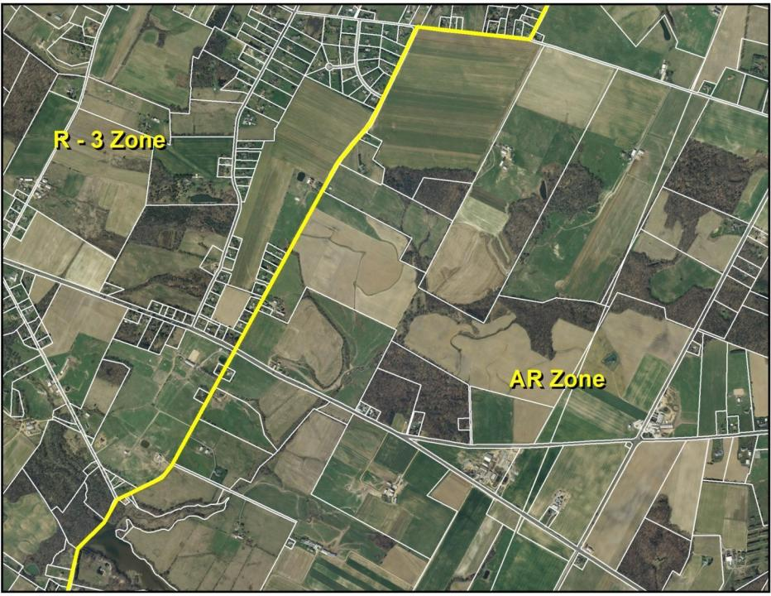
(3 Acre Lots)
(6 Acre Lots)
Notes:
Here, the subject area is located outside of a sewer service area, necessitating larger lots. Municipal zoning is split between 3-Acre Residential Zoning (R-3) in areas with access to public water and a more restrictive 6-Acre Agricultural Zone (AR).
In order to preserve the local farming industry, the Township decides to implement a noncontiguous cluster ordinance, and identifies the R-3 zone as an area appropriate for development and the AR zone as appropriate for protection under a non-contiguous cluster ordinance.

Slide 13
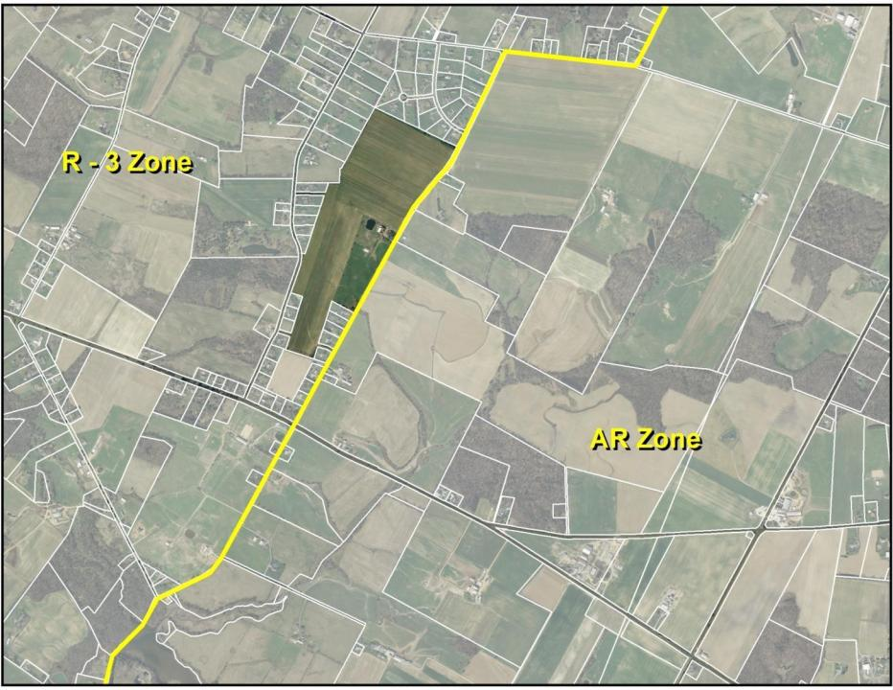
(3 Acre Lots)
(6 Acre Lots)
Notes:
The highlighted R-3 parcel is 96 acres. The R-3 lot is less desirable for agricultural production due to predominance of adjacent residential development, with the potential for right-to-farm conflicts (ie Neighbors unhappy with noise, dust, and other operations associated with farming). Under a conventional development, the site has a gross build out of 32 single family homes, given the three acre zoning. After environmental constraints, open space, and infrastructure needs are included, the net potential for the site is 24 single family homes under 3 acre zoning.

Slide 14
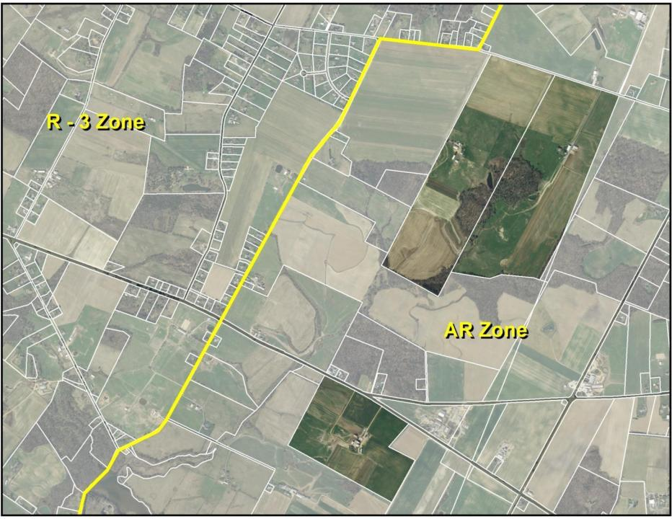
(3 Acre Lots)
(6 Acre Lots)
Notes:
The three highlighted AR parcels are 154 acres, 156 acres & 83 acres, for a total of 393 acres. These three lots are desirable for continued agricultural production due to proximity to other farm operations. This increases the operations flexibility and limits potential conflicts.
If these sites were subdivided for residential development under the 6 Acre AR Zoning, they would yield a gross build out of 65 units, with a net build out of 50 units given environment constraints, open space and infrastructure needs.

Slide 15
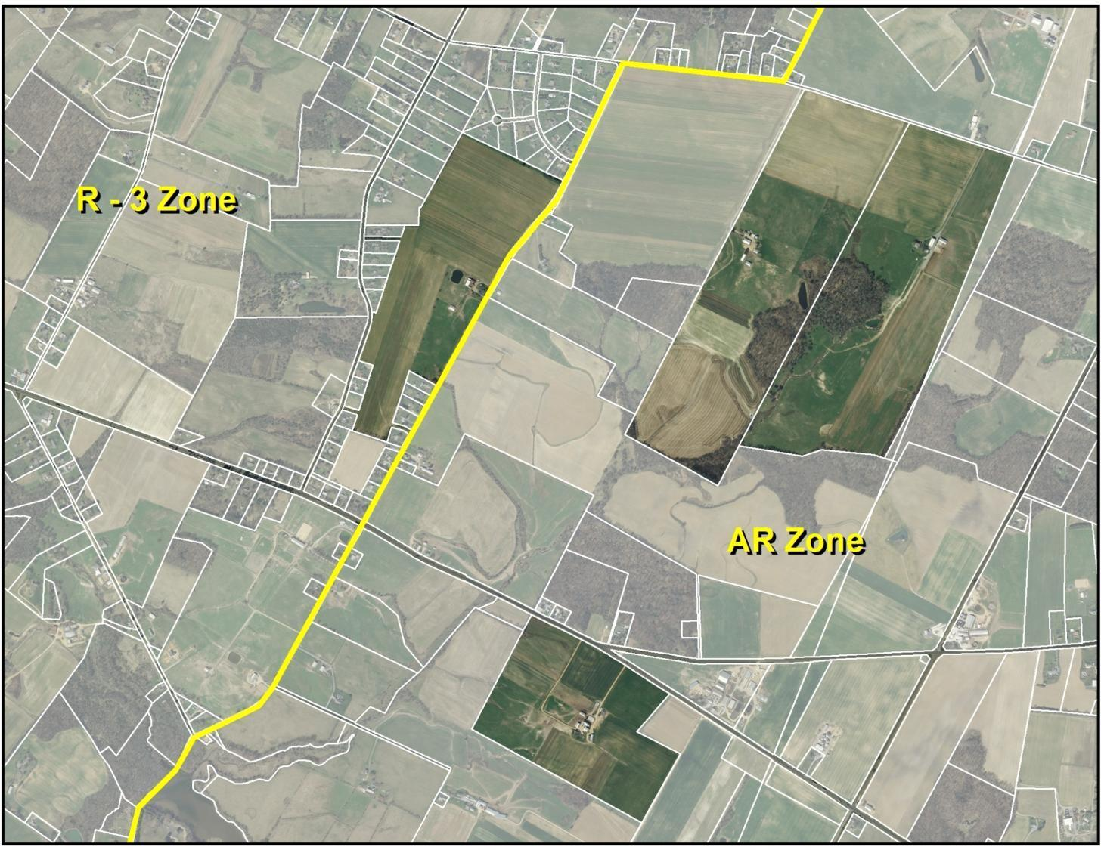
(3 Acre Lots)
(6 Acre Lots)
Notes:
However, because the Town has adopted a noncontiguous cluster ordinance, which designates the R3 Zone as an area appropriate for development, and the AR Zone appropriate for preservation, these landowners have additional options at their disposal. A developer coordinates with each of these landowners to create a single development proposal between the four parcels under the Township’s non-contiguous cluster provision.

Slide 16
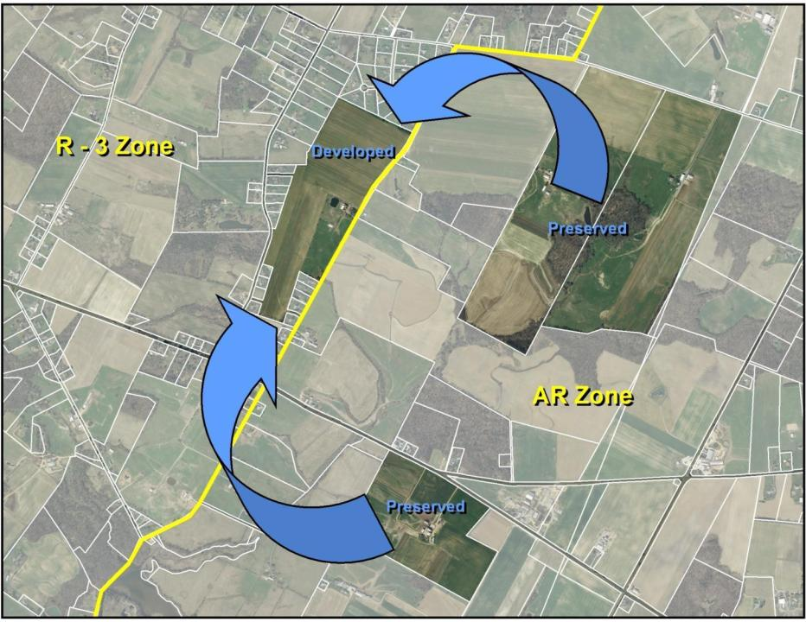
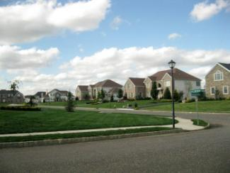
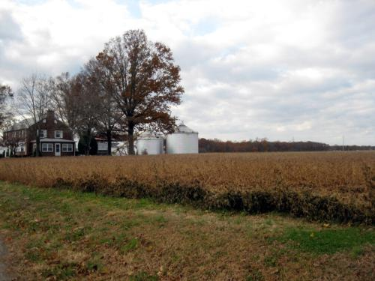
Notes:
Through implementation of the non-contiguous cluster option, the developer purchases conservation easements on properties in the AR zone in exchange for the right to develop additional units on the R-3 zone parcel.
With its access to public water the R-3 parcel can accommodate all 74 units at a gross density of one unit per 1.29 acres, while preserving 393 acres of farmland.
REFERENCE:
Conventional Zoning Outcome:
R3 Zone: 24 single family homes on 96-acre site (3-acre lots)
AR Zone: 50 single family homes on 393-acre site (6-acre lots)
Noncontiguous Cluster Outcome:
R3 Zone: 74 single family homes on 96-acre site (approximately 1-acre lots)
Ag Zone: 393 acres permanently preserved

Slide 17
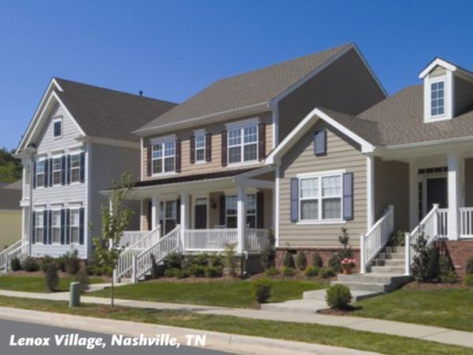
Rural Setting #2:
Clarke Caton Hintz Photo
Hamlet Development (With Sewers)
and
Forest Preservation
Notes:
Not all areas in NJ are constrained by on site septic systems. In this next example, we look at how the noncontiguous cluster could work in another hypothetical rural environment that includes an existing sewered hamlet area, and also contains several large tracts of undisturbed forests, which the municipality has expressed the desire to preserve.

Slide 18
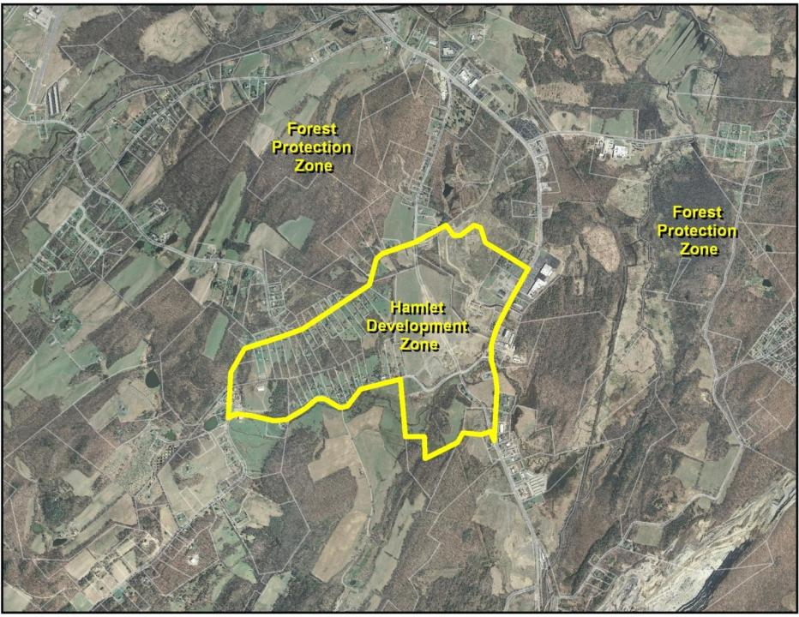
(5 Acre Lots)
(3 du/Acre Lots)
Notes:
In this rural, largely forested municipality, the zoning is split between a restrictive Forest Protection Zone (5-Acre Lots) and a Hamlet Development Zone (3 Dwelling Unit/Acre Lots). The Hamlet Development Zone was chosen due to its access to sewer service & proximity to existing development. In this zone the town hopes to a create a mixed-use center at the crossroads of two major county roads.
To encourage the development of the mixed-use center, the Township identifies the Hamlet Development Zone as an area appropriate for increased density and the Forest Protection zone as appropriate for permanent preservation under a non-contiguous cluster ordinance.

Slide 19
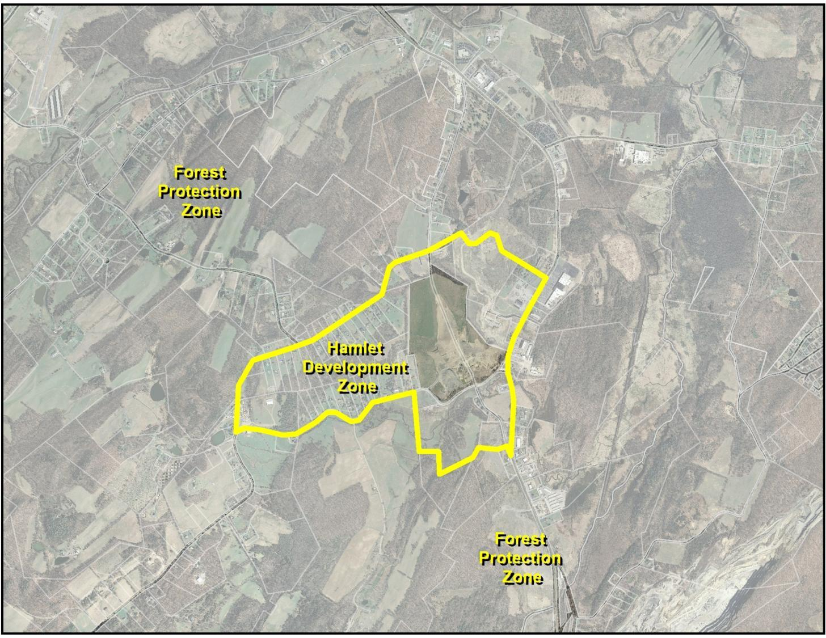
Notes:
The Hamlet Development Zone lot is desirable for development due to existing residential development, access to county roads and wastewater infrastructure.
The highlighted Hamlet Development Parcel is 66 acres. Under the present zoning of 3 dwelling units per acre, the total gross build out on the site would be 220 lots. After factoring in environmental considerations and infrastructure needs, the total potential for the site is 158 single family homes.

Slide 20
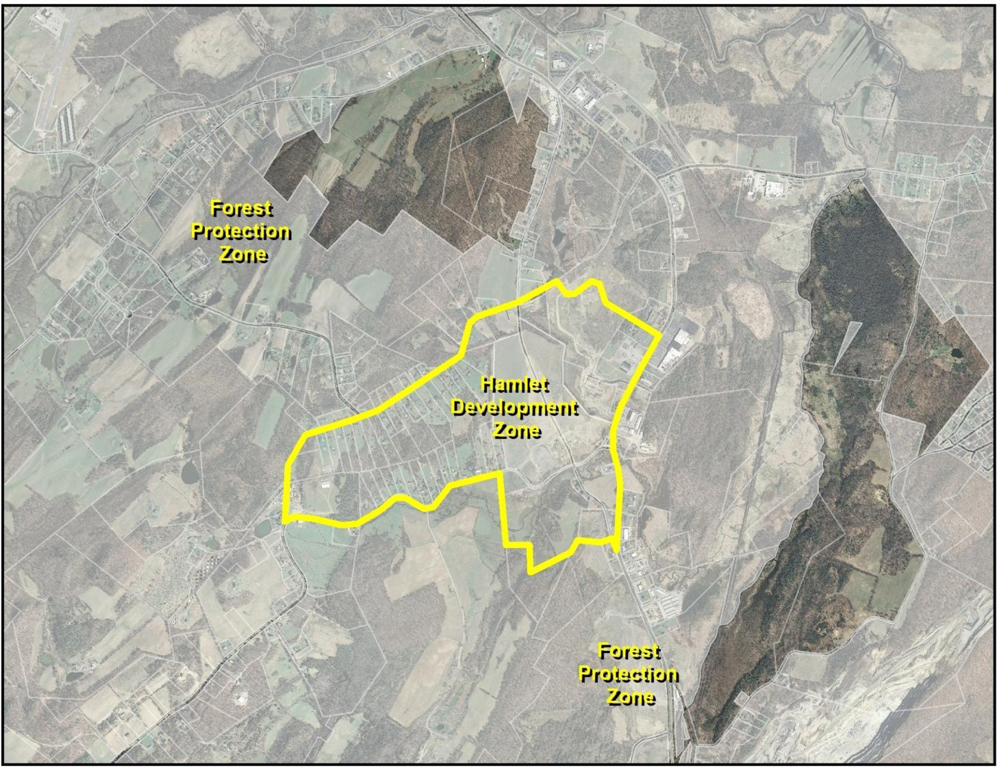
Notes:
Meanwhile, the Forest Protection Zone lots include large contiguous areas of forest and agriculture and are in proximity to similar environmentally sensitive parcels. The Town has zoned these areas for 5-Acre lots. If these 8 parcels that together comprise 635 acres were developed under conventional zoning, the total yield would be 127 lots, but after infrastructure, open space and environmental considerations, the total potential would result in the development of 106 single family homes.

Slide 21
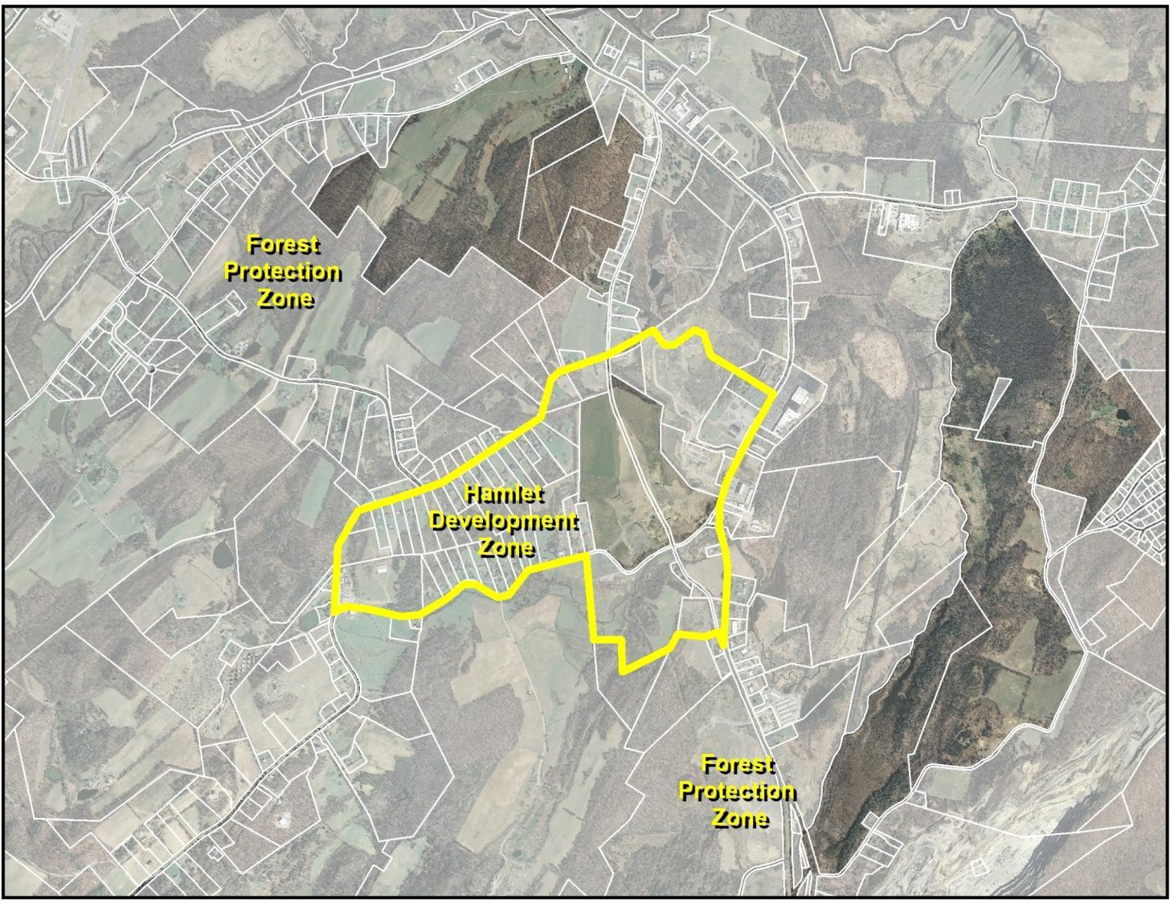
Notes:
While the parcel in the Hamlet Development Zone has a net build out of 158 units under 3 du/acre zoning, the Township permits additional development in the event of a noncontiguous cluster of up to 5 dwelling units per acre. At 5du/acre zoning, the potential net build out is 264 units. As a result, an owner of several large parcels within the Hamlet Development Zone and 8 lots within the Forest Protection Zone decides to utilize the Township’s noncontiguous cluster provision.

Slide 22
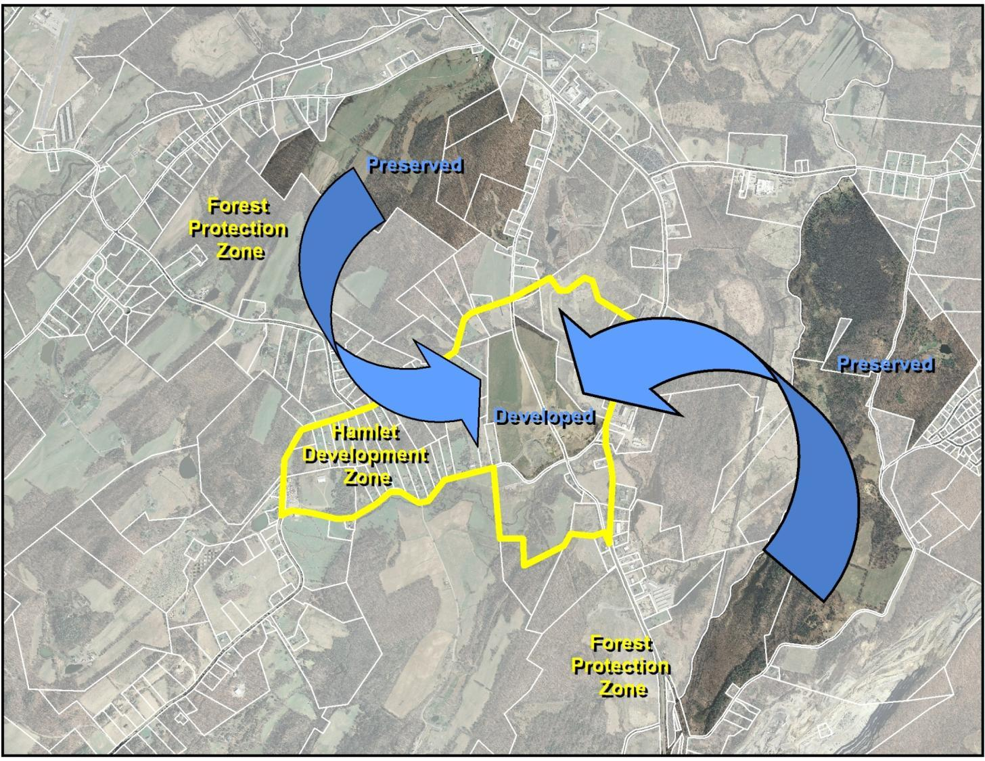

Notes:
Through implementation of the non-contiguous cluster option, the landowner places conservation easements on properties in the Forest Protection zone in exchange for the right to develop at a higher density in the Hamlet Development Zone.
At an increased density of up to 5 du/acre (.2 acre lots), development of the 66 acre Hamlet Development Zone parcel can accommodate its 158 by-right units and the additional 106 Forest Protection Zone units for a total of 264 residential units, while preserving 635 acres of forest.
REFERENCE INFORMATION:
Conventional Zoning Outcome:
Hamlet Development Zone: 158 single family homes on 66-acre site (.3-acre lots)
Forest Protection Zone: 106 single family homes on 635-acre site (5-acre lots)
Noncontiguous Cluster Outcome:
Hamlet Development Zone: 264 single family homes on 66-acre site (approximately .2-acre lots)
Forest Protection Zone: 635 acres permanently preserved

Slide 23
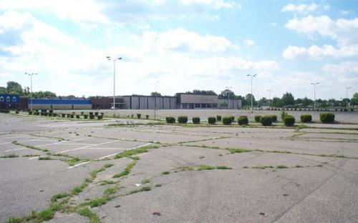
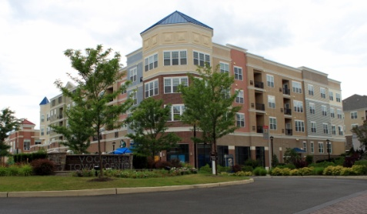
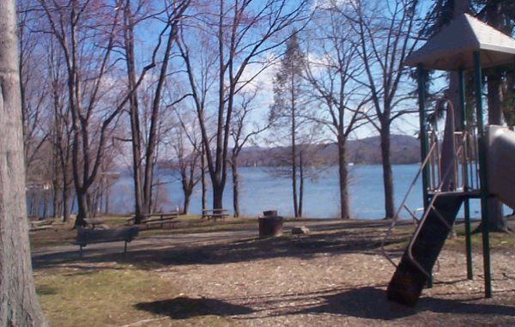
Infill Setting:
DVRPC Photo
Abandoned Strip Mall Redevelopment
and
Park Creation/Flood Management
Notes:
For many municipalities, existing development precludes the creation of new hamlet centers or the preservation of farms or woodlands. This does not mean the noncontiguous cluster is limited to greenfield development in rural areas. In this example, we demonstrate how the noncontiguous cluster can also be used as a way to revitalize an existing developed area.

Slide 24
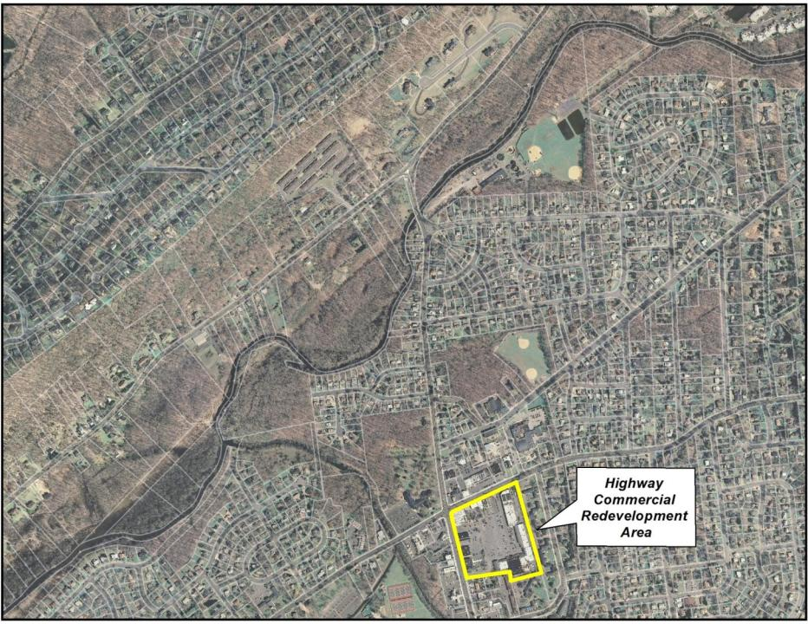
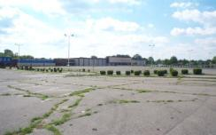
Notes:
In this hypothetical suburban municipality, the Township has identified an abandoned single-story strip mall at the intersection of two state highways with access to sewer service as part of a Highway Commercial Redevelopment Area that is appropriate for more intense development.

Slide 25
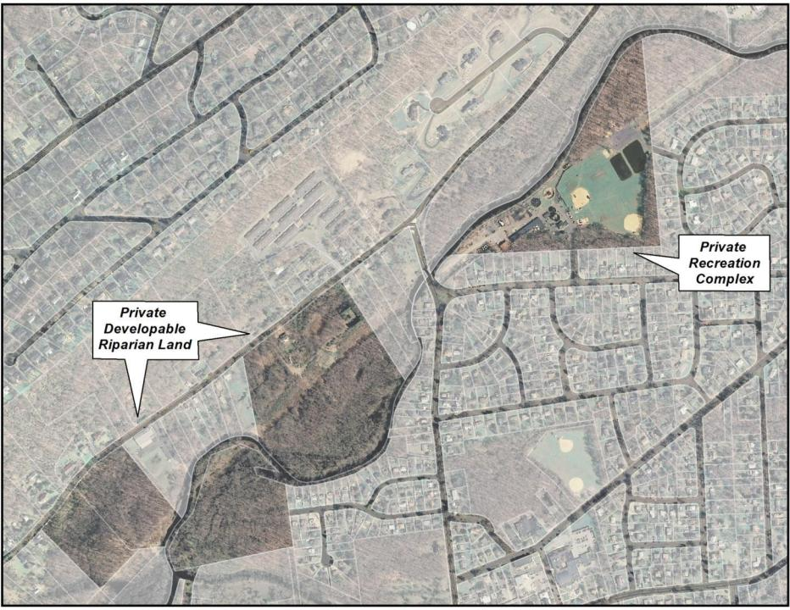
Notes:
In another part of town, the confluence of two rivers has caused flooding issues. To mitigate future flooding events, the Township identifies privately owned riparian parcels as appropriate for permanent preservation under a non-contiguous cluster ordinance.
Along the rivers, privately owned riparian lands include developable upland and wetlands which serve flood hazard protection purposes. One parcel is a private recreation facility containing ball fields. The Township would like ownership of this parcel to provide additional public recreation opportunities, as well as to create a canoe launch and increase public access to the river. The Township would like to own the wetlands for flood control.

Slide 26
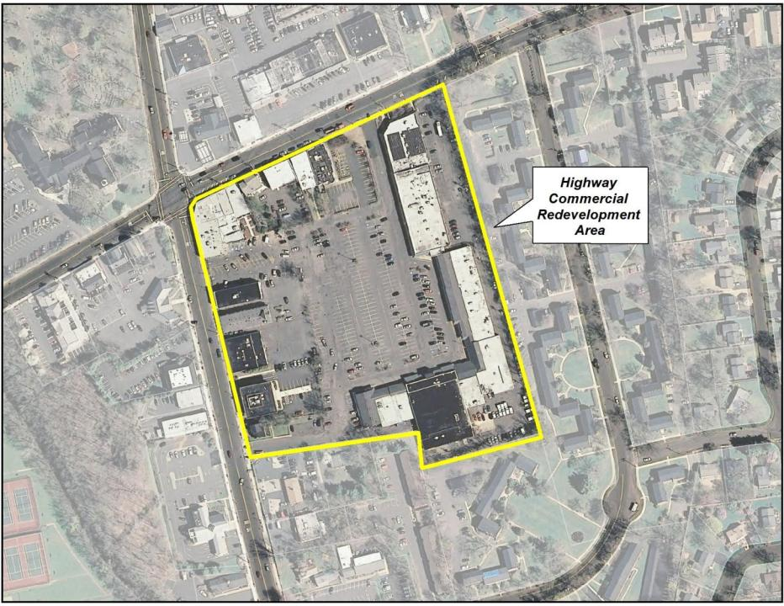
Notes:
The redevelopment area parcel is 14 acres (609,840 square feet). Existing Highway Commercial zoning permits a maximum Floor Area Ratio of .3. With 182,952 square feet (4.2 acres) of single story big box commercial space, the site is currently built to its zoned capacity. The accompanying parking lot covers most of the 14 acre site. With access to two state highways, and adequate wastewater infrastructure the township determines that the Highway Commercial Redevelopment Area could accommodate twice as much development.

Slide 27
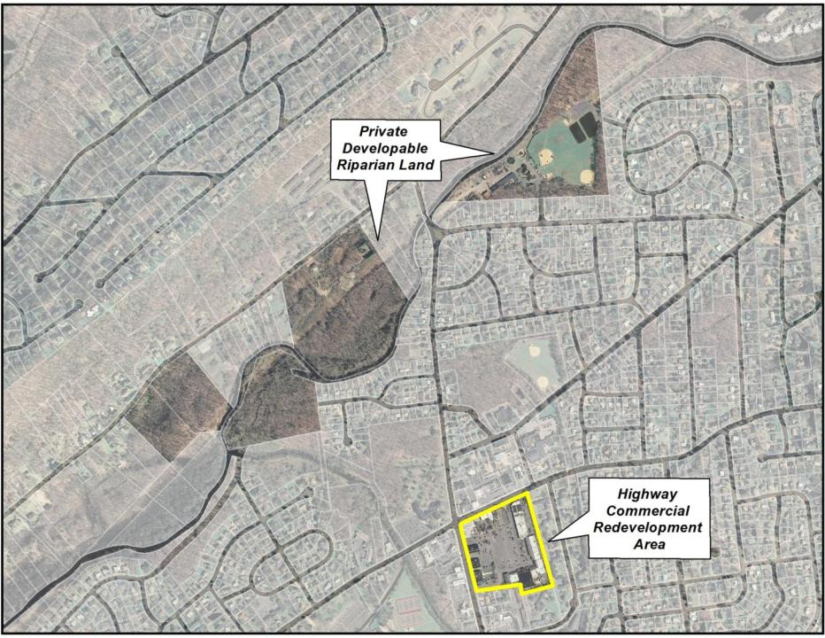
Notes:
The identified riparian parcels total 68 acres. After calculating the environmental constraints, open space and infrastructure needs, the estimated net build out is 45 single family homes.
The redeveloper of the Highway Commercial Redevelopment Area coordinates with owners of the 4 riparian parcels to create a single development proposal under the Township’s non-contiguous cluster provision.

Slide 28
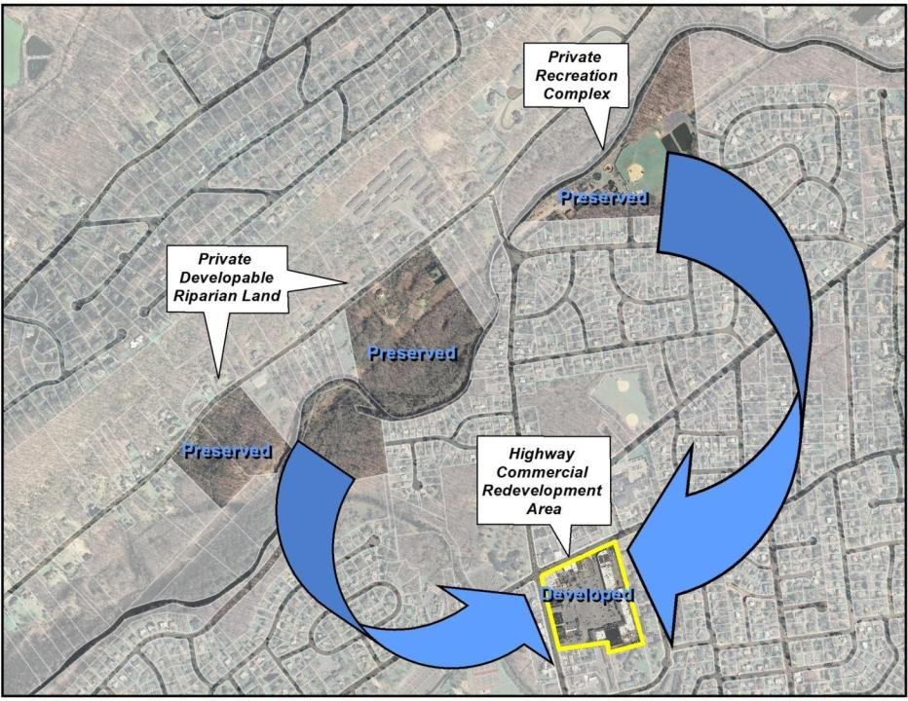
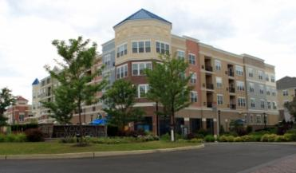
DVRPC Photo
Notes:
Through implementation of the non-contiguous cluster option, the developer purchases the riparian properties in exchange for the right to develop at a higher density in the Redevelopment Area. The township allows 4,356 square feet of additional commercial development for each riparian area housing unit. At 45 riparian units, this translates to an additional 196,020 square feet. The riparian areas are then donated to the town under a permanent easement.
Through the use of non-contiguous clustering the maximum permitted floor area ratio in the Highway Commercial Redevelopment Area more than doubles to .62, permitting the additional 196,020 square feet, for a total of 378,972 square feet.
Conventional Zoning Outcome:
Highway Commercial Redevelopment Area: FAR: 182,952 square feet (4.2 acres)
Recreation and Riparian Areas: 45 single family homes on 68-acre site (slightly over 1 acre lots)
Noncontiguous Cluster Outcome:
Highway Commercial Redevelopment Area: FAR: 378,972 square feet
Recreation and Riparian Areas: 68 acres permanently preserved

Slide 29
When is noncontiguous cluster a good choice?

Slide 30
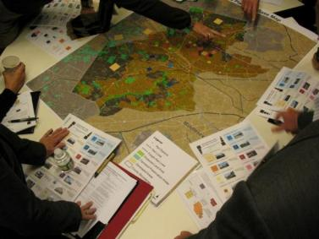
Noncontiguous Clustering Benefits: Municipalities
Affordably achieve community preservation and development goals
Preserve land or historic sites with private funds
Encourage walkable, compact growth, which has lower costs for infrastructure and services
Notes:
What’s in it for the Municipality?
Implementation of the noncontiguous cluster can allow a municipality to achieve some of its community goals in an affordable way. If a community expresses an interest to permanently preserve farmland, open space, or sites of cultural or historic significance, a municipality can encourage the use of the noncontiguous cluster to protect these interests. The noncontiguous cluster also encourages compact growth, which means a lower cost for municipal infrastructure and services than with sprawl development, such as fewer miles of road upkeep (plowing and/or sweeping) and maintenance.
In addition, “large lot development” does not have the same market appeal as it once did, particularly in rural areas. By providing landowners the option to utilize noncontiguous clustering, it enables the zoning ordinance to be more responsive to changes in market demand without a wholesale revision to the municipal zoning ordinance.

Slide 31
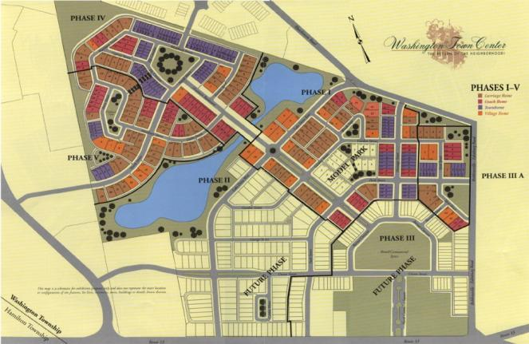
Noncontiguous Clustering Benefits: Developers
Opportunity to build compact development that meets market demand
Lower costs for roads and other infrastructure
Investment in preservation builds community support
Notes:
How does a developer benefit from the noncontiguous cluster?
Non-contiguous clustering provides flexibility within the zoning code, granting the developer an opportunity to build compact development that meets market demand. As “walkable” communities become more and more popular amongst baby boomers, seniors and even young people, developers can create communities that will attract investment. By clustering development, a developer has lower costs for roads and other infrastructure, and the guarantee in preservation helps to build community support for new growth.

Slide 32
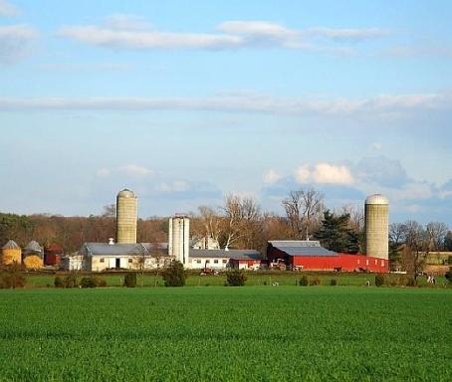
Noncontiguous Clustering Benefits: Property Owners
Preservation Area:
  Paid to keep land preserved
  Land equity retention
  Another alternative to selling to a developer
Growth Area:
  Another option for selling or developing land.
Notes:
The benefit for the property owner?
Well if you own land in the preservation area, you have more options at your disposal. You can access your equity without selling your land. For everyone else, equity retention means that your land value does not diminish. It also gives landowners another alternative to keeping their land “as is,” without having to sell to a developer. This is especially true for properties that would like to be preserved under a state land preservation program but do not rank high enough to be selected for preservation.
For landowners in the growth area, you now have another option for selling or developing your land.

Slide 33
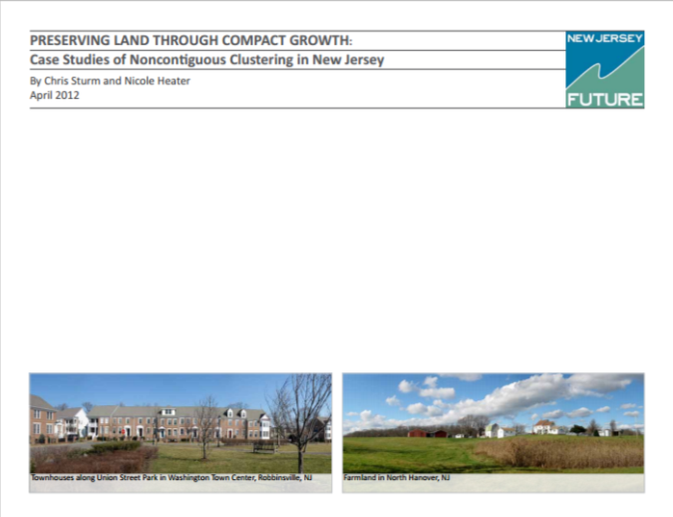
Implementation in New Jersey
Ten towns with ordinances:
Delaware
Hillsborough*
Hopewell
Middle
Monroe*
Mt. Olive*
North Hanover
Ocean
Plainsboro*
Robbinsville*
* Five towns with noncontiguous cluster developments

Slide 34
How Was the Tool Improved?
August 2013 legislation improved authorization for cluster programs
More municipal control over growth and preservation
Easier for developers and landowners to implement
Notes:
You may have heard of some communities implementing a noncontiguous cluster before. However, New Jersey’s Municipal Land Use Law was not as clear as it could have been, and two municipal noncontiguous cluster ordinances were subsequently struck down in court. Under the new law, municipalities now have clear legal authority to designate growth areas and preservation areas.
REFERENCE INFORMATION:
-Communities that have implemented the noncontiguous cluster include:
-Delaware Township (Hunterdon County)
-Hillsborough Township (Somerset County)
-Hopewell Township (Mercer County)
-Middle Township (Cape May County)
-Monroe Township (Middlesex County)
-North Hanover Township (Burlington County)
-Ocean Township (Ocean County)
-Plainsboro Township (Middlesex County)
-Robbinsville Township (Mercer County)

Slide 35
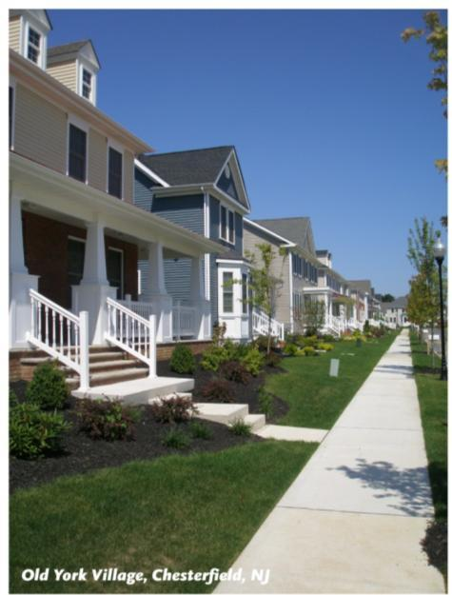
Other Preservation Tools
Acquisition
  Pro: Full preservation
  Con: Very Expensive
Contiguous clustering
  Useful on a single parcel
Transfer of development rights
  Pro: More control
  Con: Greater costs/regulation
Clarke Caton Hintz Photo
Notes:
Zoning is a municipality’s most basic and essential land use tool to regulate and control growth. Zoning also provides the basis for all other land use tools that we will discuss.
With large lot zoning, the larger the lot size, the fewer the number of dwellings or buildings that can be permitted within the district. Unfortunately, when used alone, this tool does not offer any protection for open space and also encourages sprawl development.
The contiguous cluster concentrates development on one part of a site or set of neighboring parcels, permanently preserving the remaining land. What limits this tool is that it can only be used on a single parcel, or in conjunction with a neighboring parcel, meaning that the entire site or region cannot be planned for open space or growth.
Transfer of Development Rights (or TDR) is similar to the noncontiguous cluster in that it moves development from one parcel to another, using a market-driven approach. The program can guarantee more control as seen in some notable preservation success stories in New Jersey, such as Chesterfield (inset photo), however implementation of a TDR program requires extensive planning on the part of the municipality (meaning time and money) to implement the program and meet state requirements under a patchwork of different agencies.

Slide 36
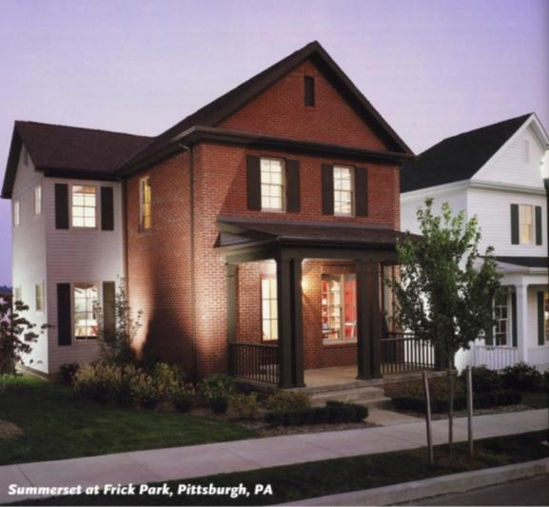
When is Noncontiguous Clustering right for you?
Pro:
A municipality should choose noncontiguous clustering to:
  Achieve compact growth
  Encourage preservation at little to no public cost
A municipality should chose noncontiguous clustering when it lacks:
  the means or resources to undertake a TDR program
  The funds to buy all the land it wants to preserve
Noncontiguous clustering requires minimal costs to implement.
Con:
Limited control over outcomes
Depends upon voluntary participation
May need to offer density bonus
Clarke Caton Hintz Photo
Notes:
The intention of this presentation is not to say that the noncontiguous cluster is the cure-all solution for municipal land use planning. Each of the tools highlighted in the previous section have their benefits and drawbacks, and when used in concert with each other, can yield successful results. If the political or public will is not willing to adopt a noncontiguous cluster ordinance, or if a community wants to guarantee a specified preservation target, then other tools should be considered. On the other hand the noncontiguous cluster may help municipalities to advance their land development and preservation goals, whether that is to preserve farmland and a viable farming industry, create recreation opportunities through preserved open space, protect people from hazardous flooding areas or even protect community character through the preservation of historic buildings or places, in addition to reducing infrastructure costs and attaining public support.
Now that we have an idea of how noncontiguous clustering works, lets examine a few scenarios of how it could be done.

Slide 37
Planning an attractive growth area

Slide 38
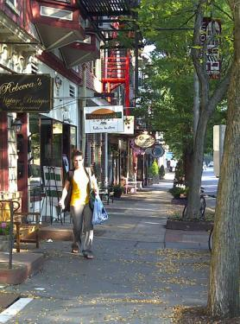
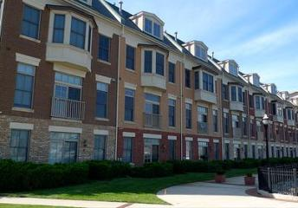
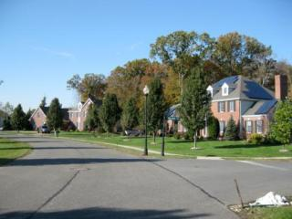
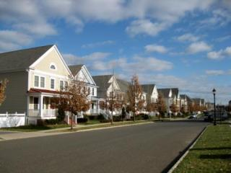
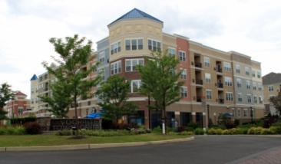
What can a growth area look like?
Notes:
So what can a growth area look like on the ground? The noncontiguous cluster lets municipalities focus their goals, desires and character in specific areas. Whether the noncontiguous cluster is used in a rural setting, a small town, a suburb, or more urbanized area, the intent is to create growth areas that foster livability, while using preservation areas to protect the natural and cultural assets of the community, such as farms, open space, and even historic buildings.

Slide 39
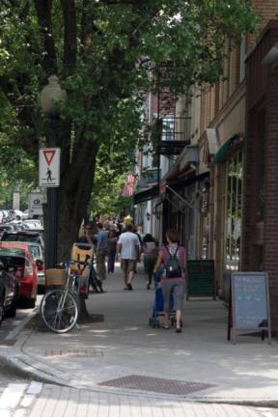
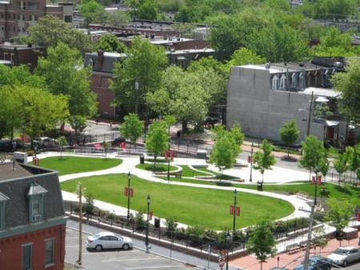
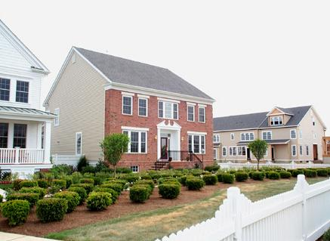
Planning Attractive Communities
Walkable
Pedestrian oriented design
Design standards
Avoids sprawl
Mixed use
Adds value
Notes:
By avoiding “sprawl” development and focusing the scale to that of a pedestrian, the noncontiguous cluster can help create attractive communities that create value. And what can a residential community look like?

Slide 40
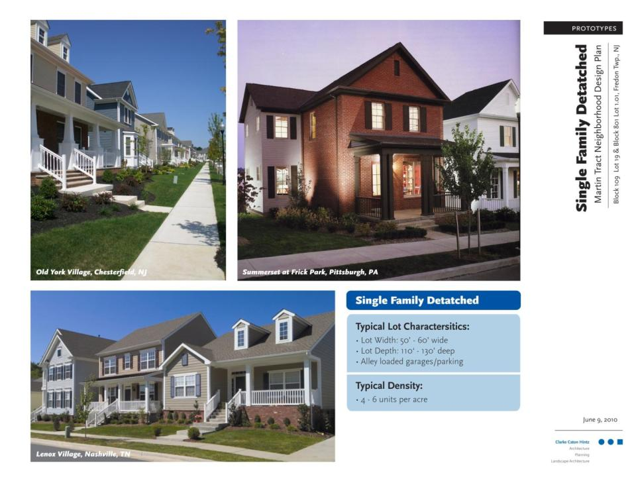
Notes:
A well planned, attractive growth area should contain a variety of housing options, sizes and designs. These pictures show new development of single family residences at 4-6 units per acre (.25-.16 acre lots)

Slide 41
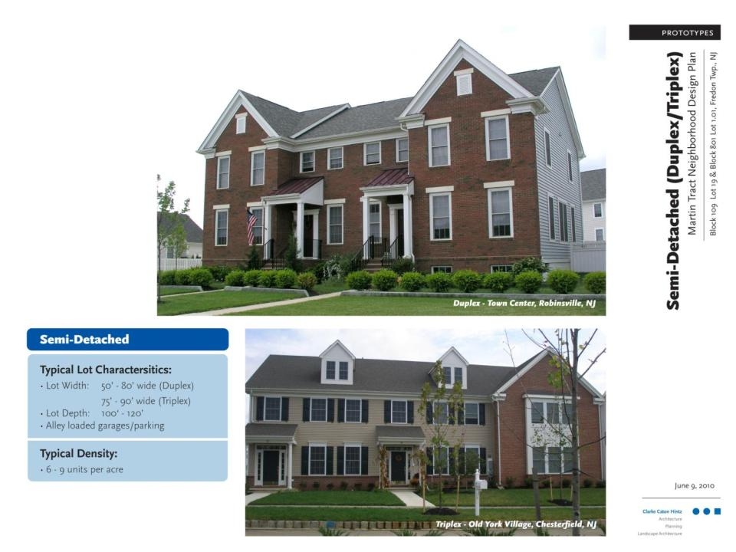
Notes:
Other options could include semi-detached housing (what you would refer to as a duplex or triplex) at 6-9 units per acre (.16-.11 acre lots)

Slide 42
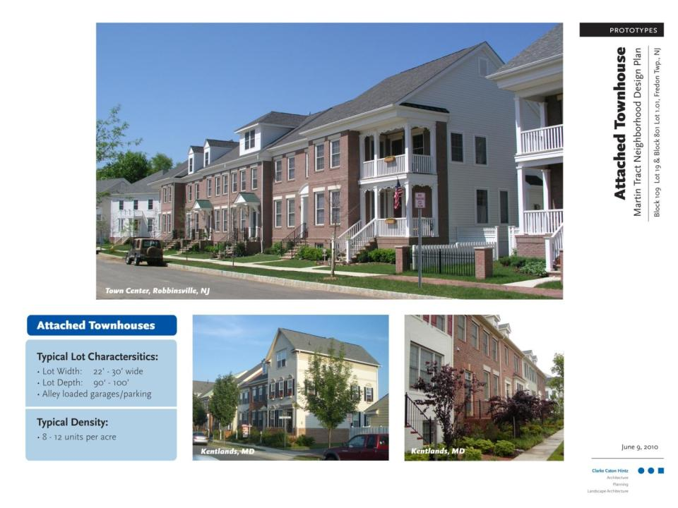
Notes:
Townhomes at 8-12 units per acre (.125-.08 acre lots)

Slide 43


Notes:
Townhomes over flats (12-16 units per acre)

Slide 44

Notes:
Multi-family development (16-24 units per acre)

Slide 45

Notes:
As well as a mix of uses that incorporates commercial space with all of the previously mentioned housing choices. What all of these options have in common is that they help create livable communities.

Slide 46


Slide 47

Noncontiguous Clustering: New Jersey’s New & Improved Planning Tool
Utilizes existing infrastructure
Preserves natural and cultural assets
Fosters “walkable” neighborhoods
Notes:
The noncontiguous cluster gives municipalities another tool that they can choose to incorporate into their land use policies. The tool helps to preserve important cultural and natural assets of a community, while fostering development where it makes sense, while saving taxpayers the unnecessary expenses of unneeded infrastructure. When used appropriately, the noncontiguous cluster can help to enhance and plan attractive communities that meet the needs of residents, farms, and businesses.

Slide 48
Questions and Answers

Slide 49
Thank you!

