Slide 1
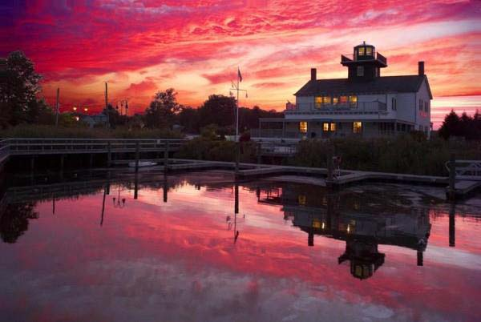

Planning For Our Coastal Future
Meeting #1-Vulnerabilty Analysis
4-14-15

Slide 2

Agenda
Introductions
Interactive audience poll
Vulnerability analysis
Probabilities discussion
Vulnerability analysis continued
Community risk survey
Short- and long-term adaptation strategies
Questions, next steps

Slide 3
Who we Are

Slide 4
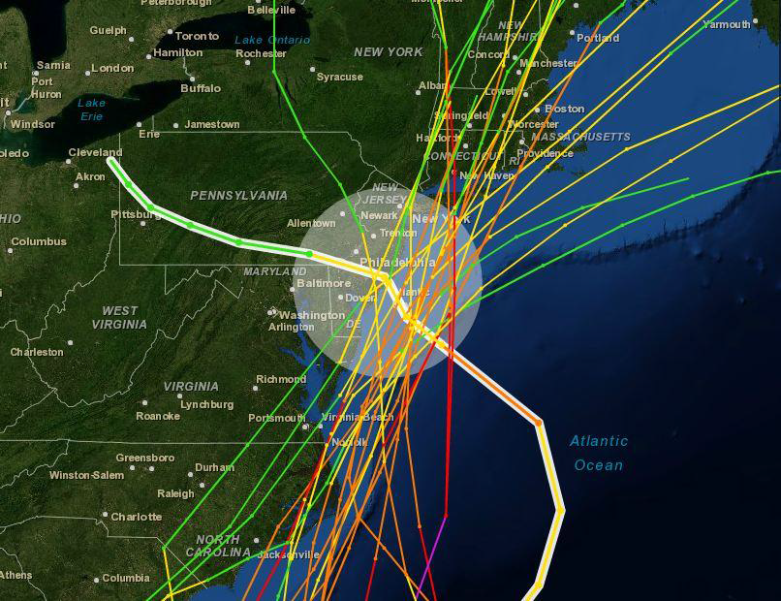
Initial Involvement
  FEMA seeking a partner for local recovery effort
  FEMA/Merck Foundation request to create LRPM position
  FEMA noted lack of local capacity in disaster response
  NJ Recovery Fund provided additional funding

Slide 5
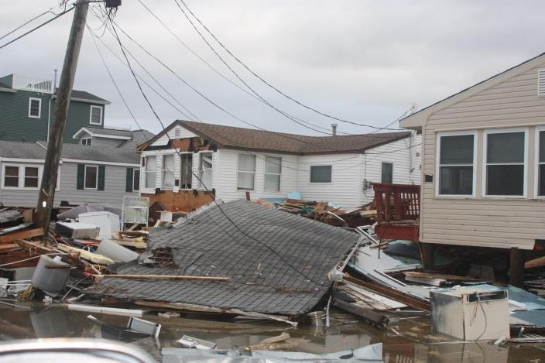
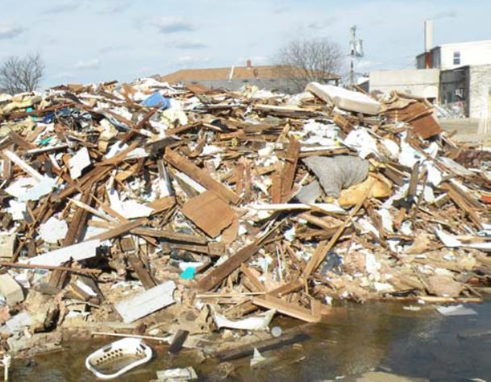
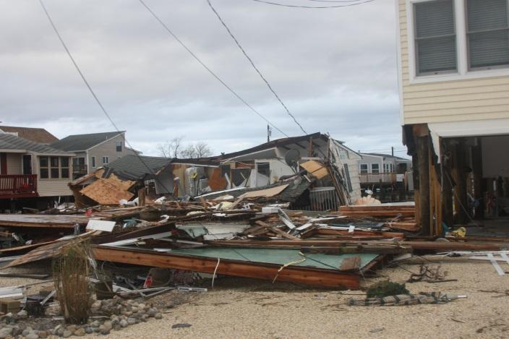
The Program
Screening Criteria
  Considerable storm damage
  Limited or no in-house planning capabilities
  Primarily full-time residents

Slide 6
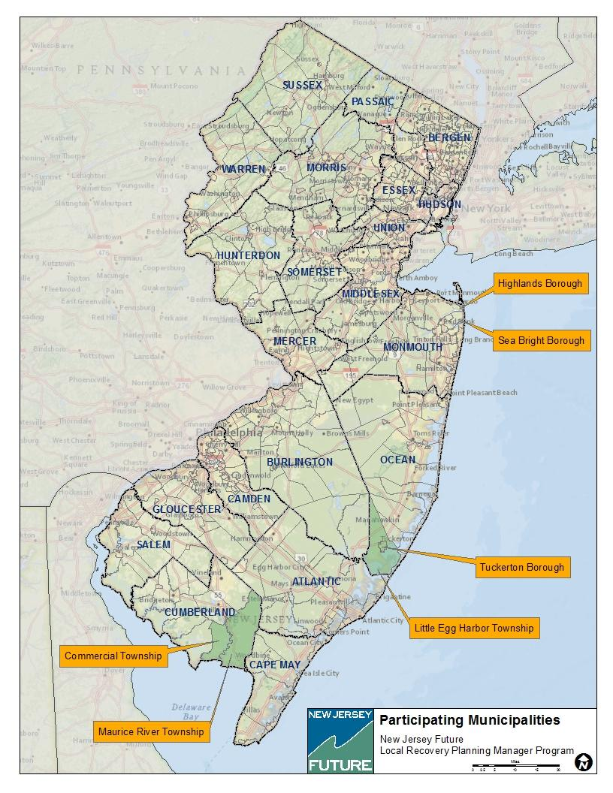
Who We Work With

Slide 7
Vulnerability Analysis

Slide 8
Why Do A Vulnerability Analysis?
Purpose:
  Evaluate vulnerability to likely hazards;
  Prioritize those actions that most effectively reduce or avoid future loss.
“If I had an hour to solve a problem I’d spend 55 minutes thinking about the problem and 5 minutes thinking about solutions.”
-Albert Einstein

Slide 9

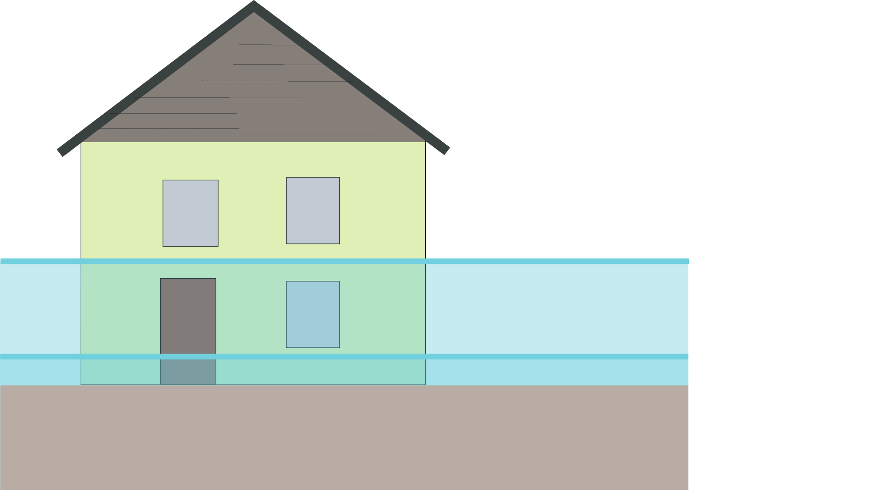
3 Step Process
  Inundation Extent
  Inundation Depth
  Estimation of Exposure
  NOTE: SLR projections from Rutgers University
  Department of Earth and Planetary Sciences

Slide 10
Results

Slide 11
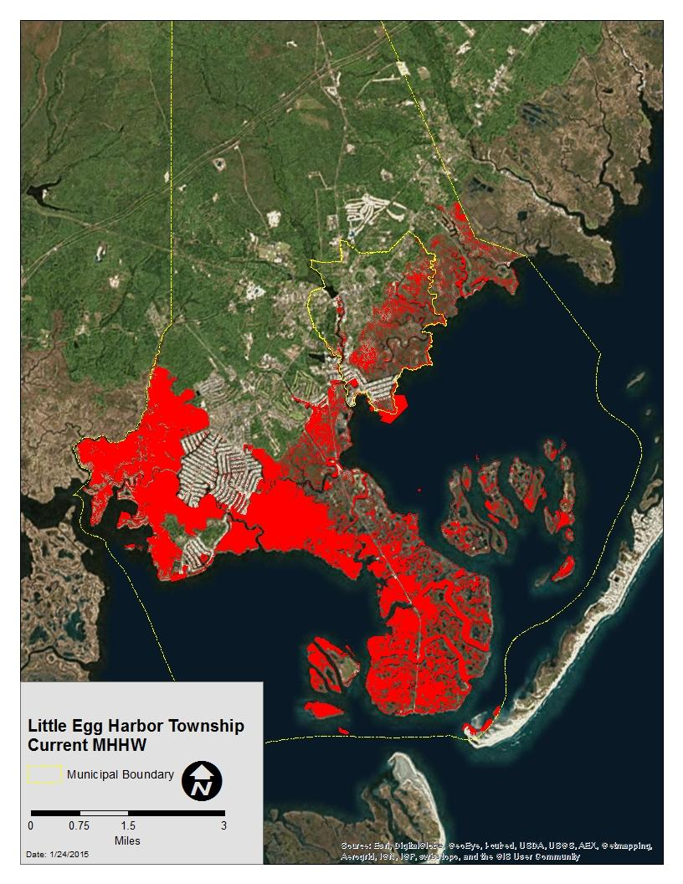
Little Egg Harbor Township – Current

Slide 12
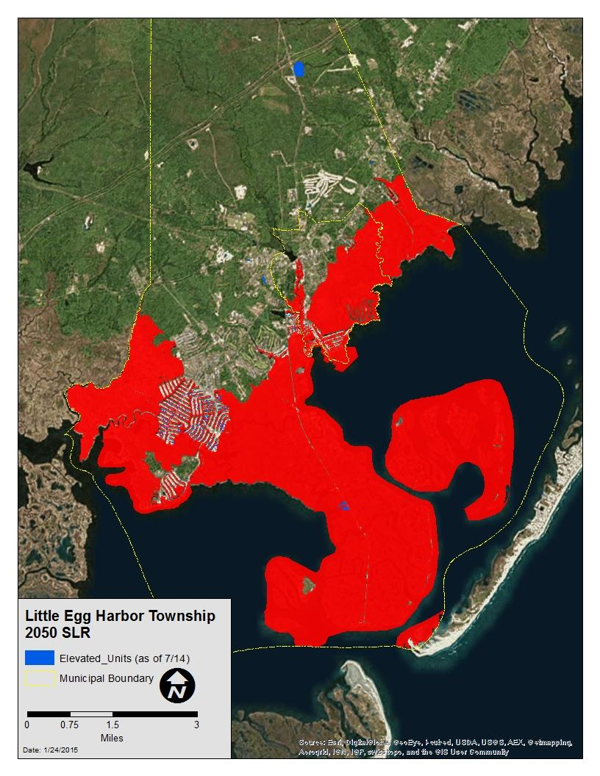
Little Egg Harbor Township – 2050 SLR

Slide 13
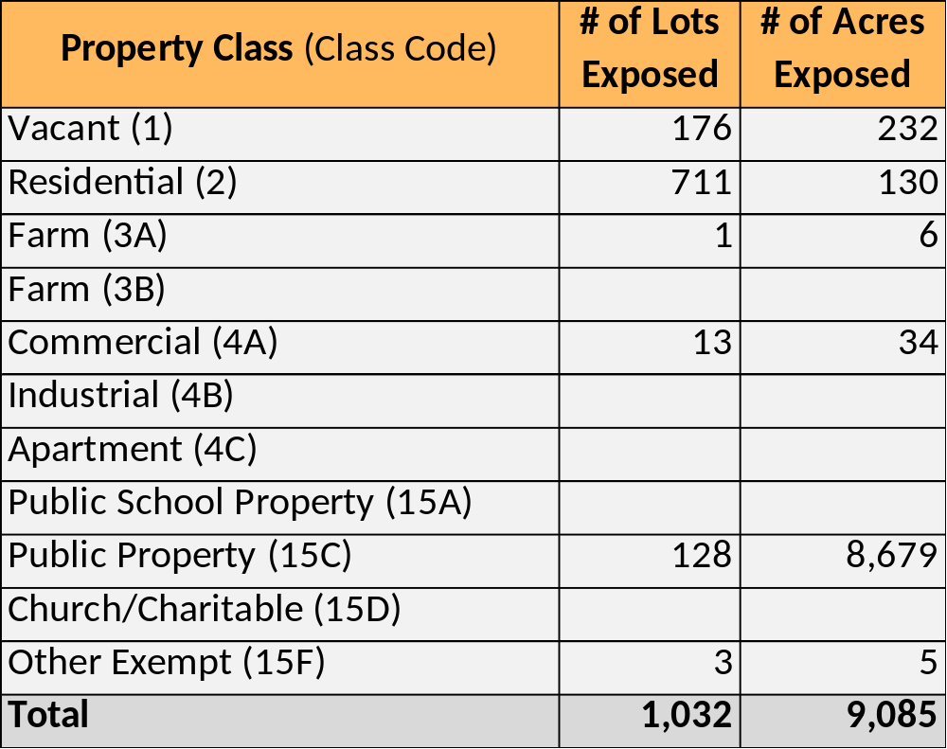
Little Egg Harbor Township – 2050 SLR Scenario, Parcels
The Bottom Line
  Total Exposed Lots: 1,032
  % of Total Lots: 8%
  Total Exposed Acres: 9,085
  % of Total Acres: 31%

Slide 14
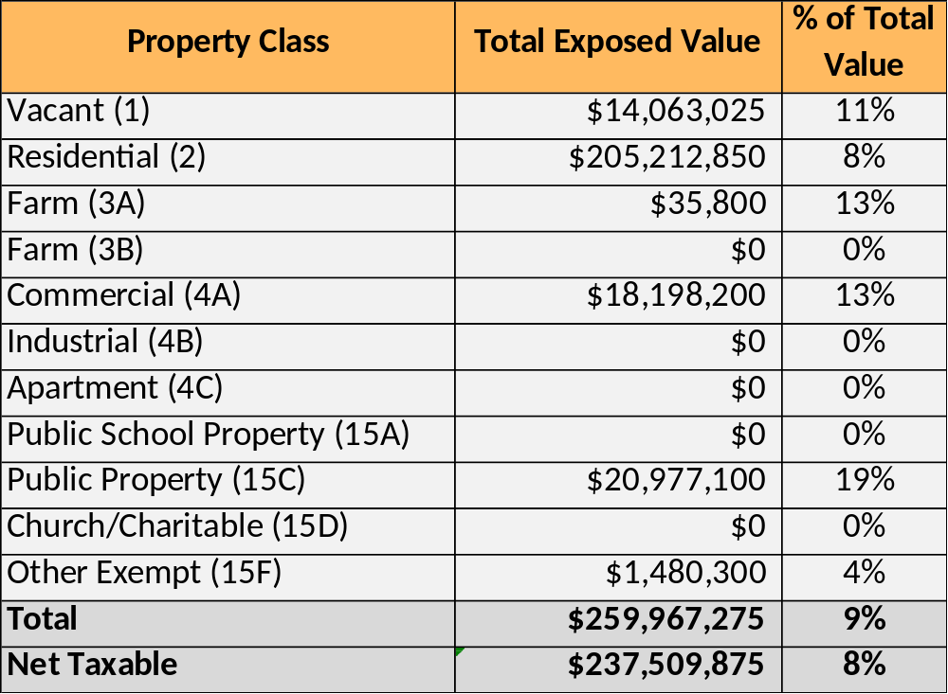
Little Egg Harbor Township – 2050 SLR Scenario, Value
The Bottom Line
  Exposed Net Taxable Value: $237.5 million
  % of Total Value: 8%

Slide 15
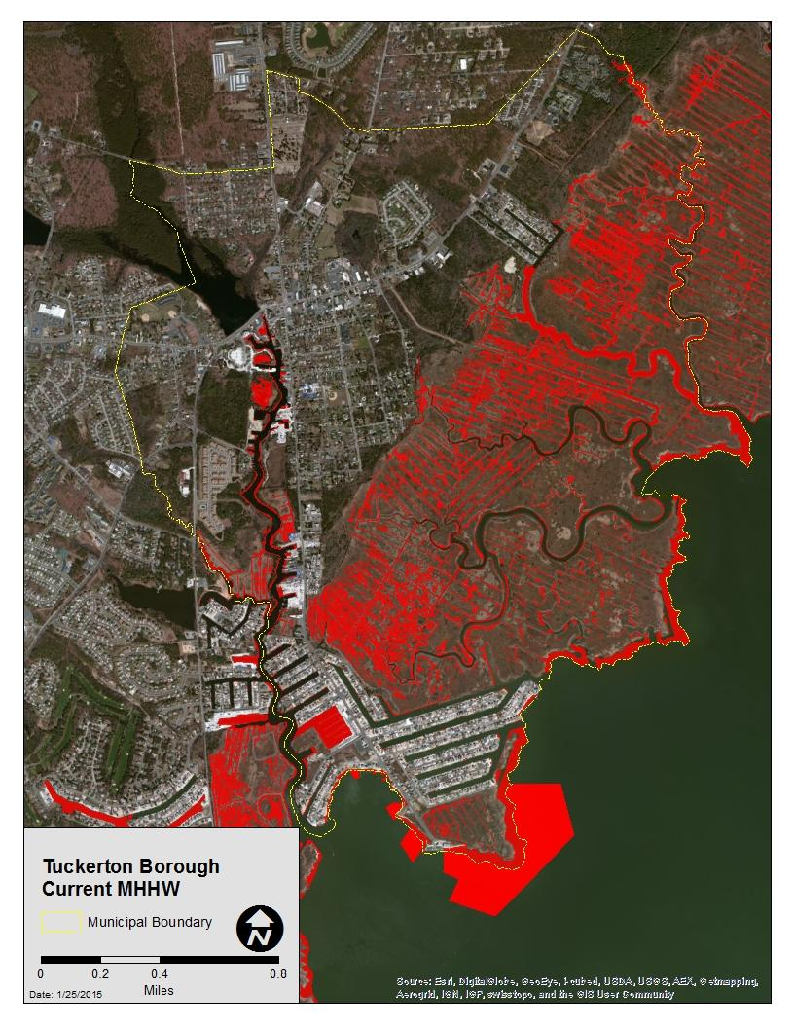
Tuckerton Borough - Current

Slide 16
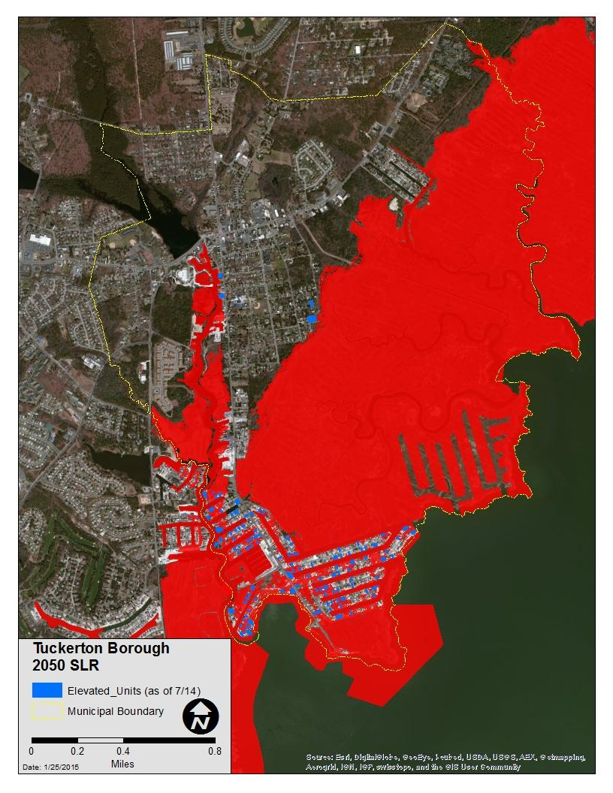
Tuckerton Borough – 2050 SLR

Slide 17
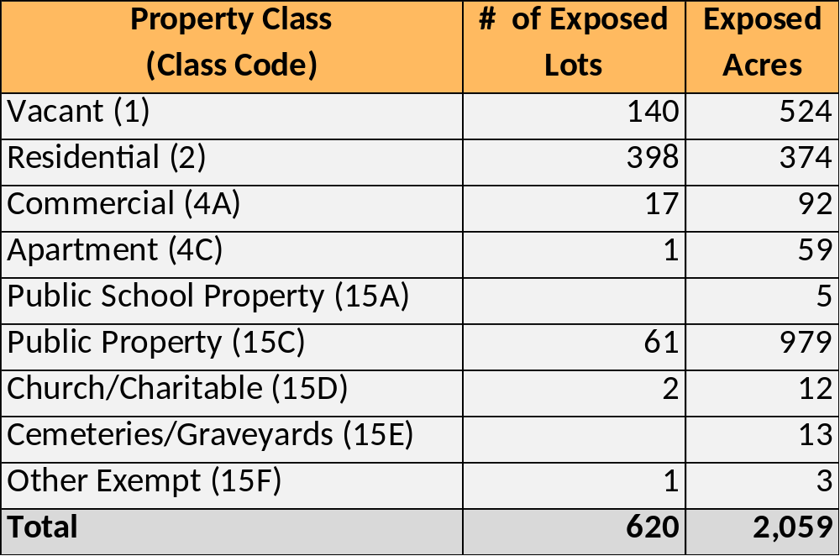
Tuckerton Borough – 2050 SLR Scenario, Parcels
The Bottom Line
  Total Exposed Lots: 620
  % of Total Lots: 28%
  Total Exposed Acres: 1,131
  % of Total Acres: 55%

Slide 18
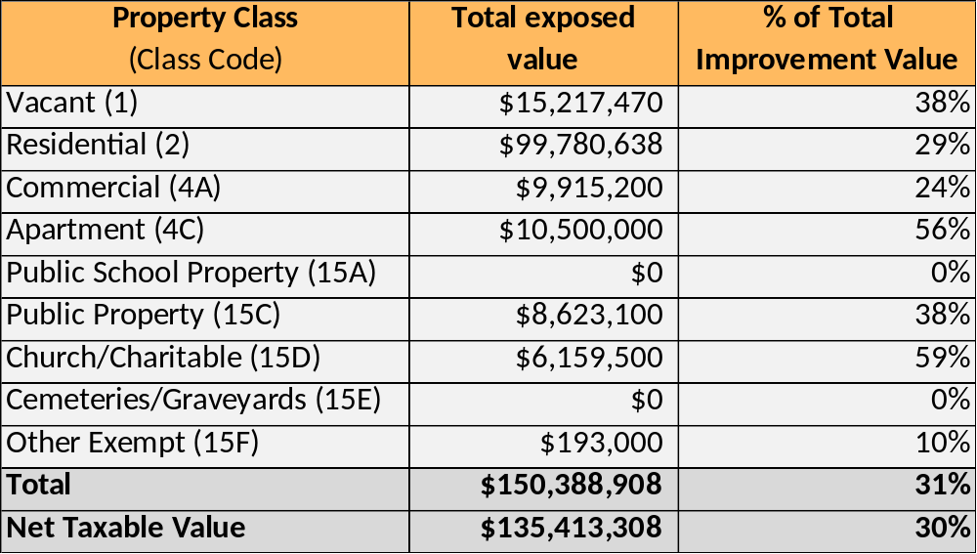
Tuckerton Borough – 2050 SLR Scenario, Value
The Bottom Line
  Exposed Net Taxable Value: $135.4 million
  % of Total Value: 30%

Slide 19
Results Continued

Slide 20
Little Egg Harbor Township – Current

Slide 21
Little Egg Harbor Township – 2050 SLR

Slide 22
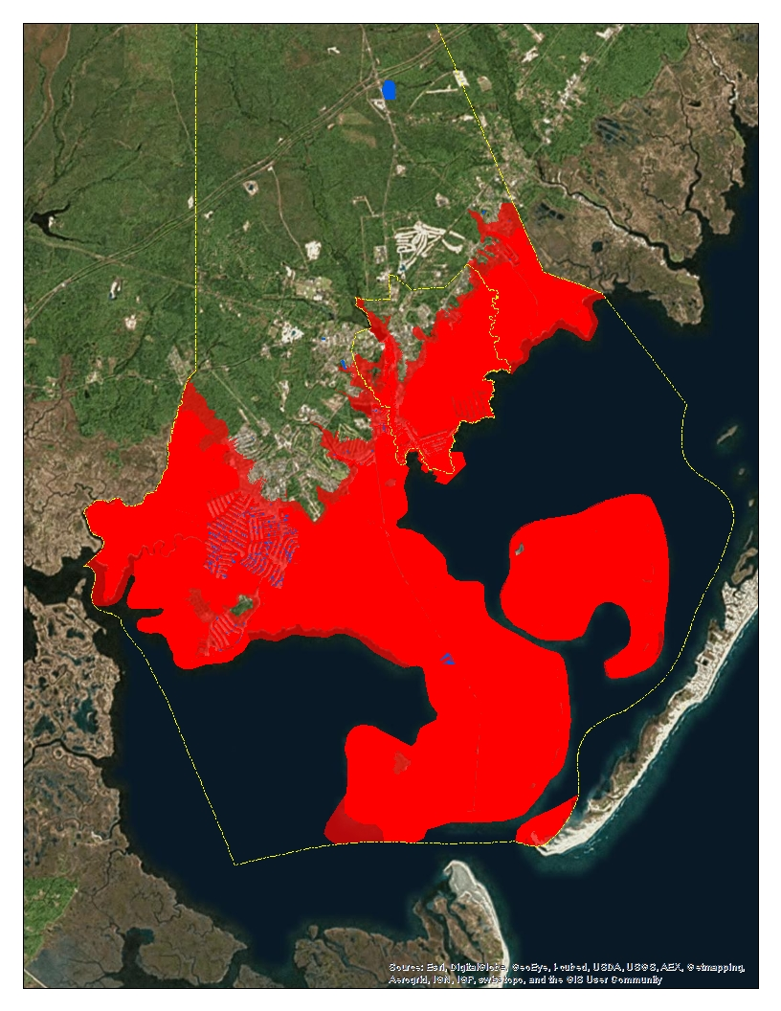
Little Egg Harbor Township – 2050 SLR/1% Storm

Slide 23
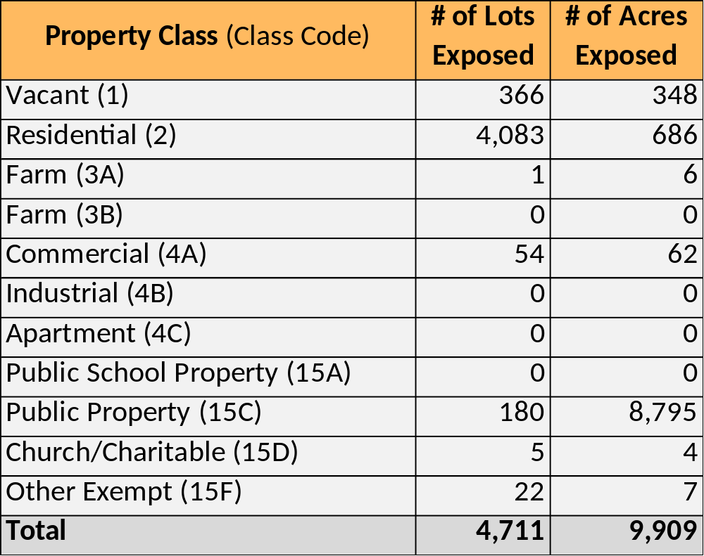
Little Egg Harbor Township – 2050 SLR/1% Storm, Parcels
The Bottom Line
  Total Exposed Lots: 4,711
  % of Total Lots: 36%
  Total Exposed Acres: 9,909
  % of Total Acres: 34%

Slide 24
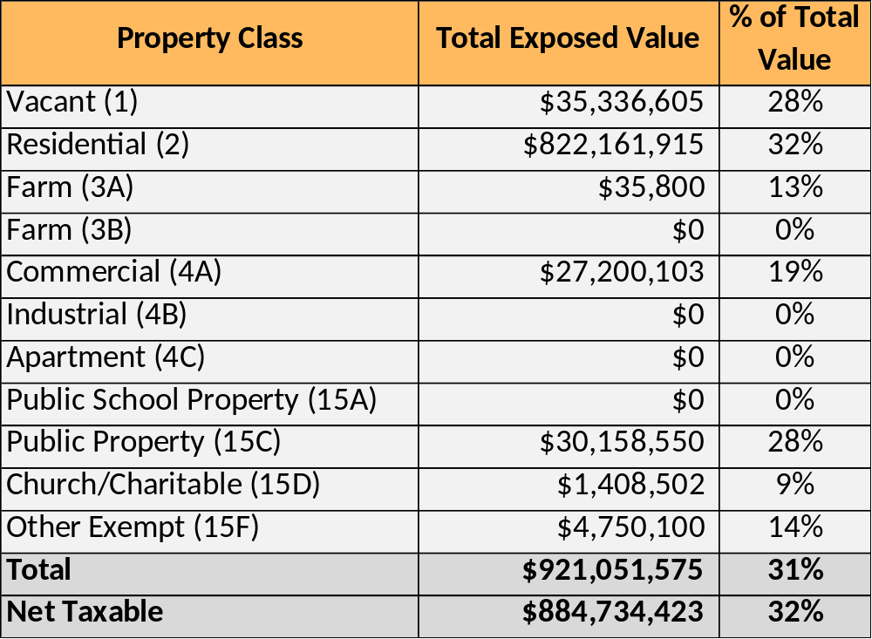
Little Egg Harbor Township – 2050 SLR/1% Storm, Value
The Bottom Line
  Exposed Net Taxable Value: $884.7 million
  % of Total Value: 32%

Slide 25
Tuckerton Borough - Current

Slide 26
Tuckerton Borough – 2050 SLR

Slide 27
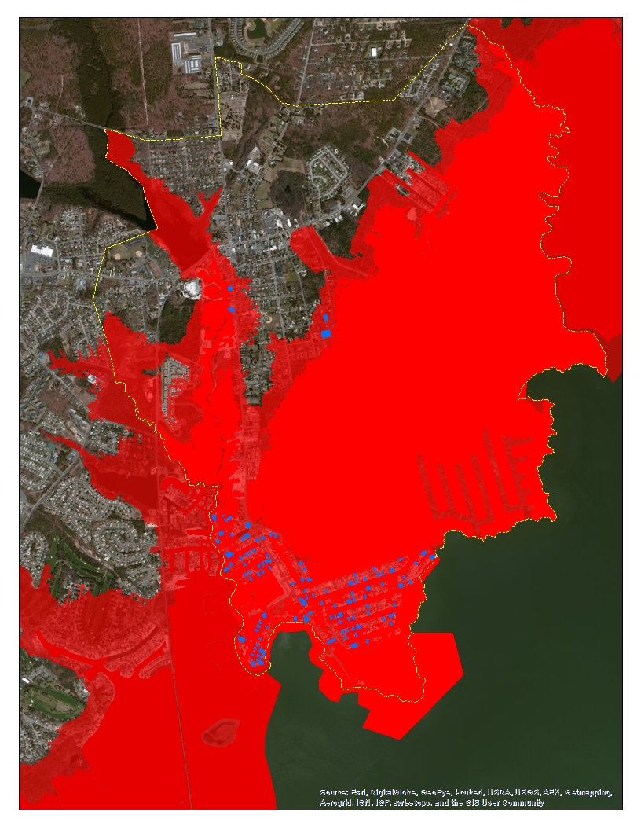
Tuckerton Borough – 2050 SLR/1% Storm

Slide 28

Tuckerton Borough - 2050 SLR /1% Flood Scenario, Parcels
The Bottom Line
  Total Exposed Lots: 1,219
  % of Total Lots: 55%
  Total Exposed Acres: 1,357
  % of Total Acres: 66%

Slide 29

Tuckerton Borough - 2050 SLR /1% Flood Scenario, Value
The Bottom Line
  Exposed Net Taxable Value: $224.4 million
  % of Total Value: 50%

Slide 30

Time for a new approach
Insanity: doing the same thing over and over again and expecting different results

Slide 31
Community Survey

Slide 32
Community Survey

Slide 33
Preparing For Risk
Create behaviorally realistic communications to help people meet the threat of sea level rise
What are views on the risk and preparing for that risk?
Gabrielle Wong-Parodi¹, Baruch Fischhoff¹, & Ben Strauss²
Carnegie Mellon University¹
Climate Central²

Slide 34
Preparing For Risk
  Open-ended interviews – capture views about risk, preparation
  Local surveys – informed by interviews, identify prevalence of beliefs and practices
  Representative surveys – informed by interviews/local surveys, identify prevalence of beliefs and practices
Views on the risk and preparing for that risk
Interviews
Spring 2014
Local Surveys
Summer 2014
Representative Surveys
Summer 2015

Slide 35
Preparing For Risk
  14 open-ended interviews in Little Egg, Tuckerton, Sea Bright, Highlands
  Participants
    All full-time residents (20+ years)
    Average age 62.4 years
    69.2% with at least a college degree
    41.6% female
Views on the risk and preparing for that risk
Interviews Spring 2014
Local Surveys
Summer 2014
Representative Surveys
Summer 2015

Slide 36
Preparing For Risk
  What do people think about the risk?
    “What is causing it? I can’t really say. It could be just a natural cycle. It could be contributed to global – ice melting or whatever. But either way, it is happening…something is different in the last 52 years in this area” (participant 8)
    “…you live in a coastal town, so it’s kind of expected that if you can afford to live near the ocean you have to know that there’s certain risks” (participant 3)
  Risk increasing (drawing from own experience); sense of responsibility for meeting threat
Views on the risk and preparing for that risk
Interviews Spring 2014
Local Surveys
Summer 2014
Representative Surveys
Summer 2015

Slide 37
Preparing For Risk
  225 participants in Little Egg, Tuckerton, Sea Bright, Highlands
  Participants
    55.2% long-time residents (at least 15 years)
    Average age 57.1 years (SD=11.6 years)
    51.0% with at least a college degree
    49.2% female
    50.5% with an annual income of at least $76k
    33.9% Independent, 31.2% Republican, 15.6% Democrat, 2.7% Other, 16.7% prefer not to answer
    63.4% think climate change is happening, 19.6% don’t know, 17.0% think it’s not happening
Views on the risk and preparing for that risk
Interviews
Spring 2014
Interviews Spring 2014
Local Surveys
Summer 2014
Representative Surveys
Summer 2015

Slide 38
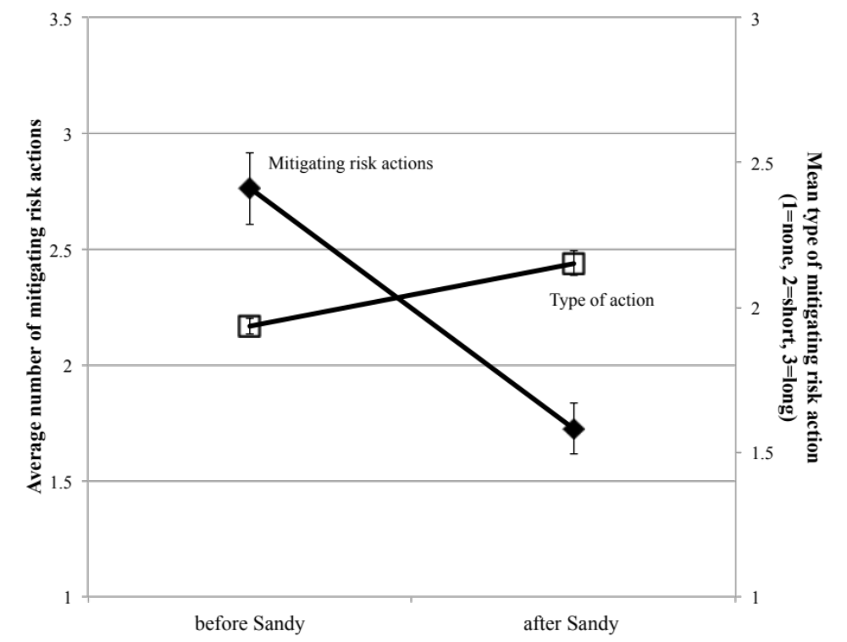
Preparing For Risk
  How does flooding experience affect preparation?
Views on the risk and preparing for that risk
Interviews Spring 2014
Local Surveys
Summer 2014
Representative Surveys
Summer 2015

Slide 39
Preparing For Risk
  1,150 participants high-risk communities in NJ, NY and CT
  Participants
    Probabilistic sample
    Statistically representative of high-risk communities across demographics (age, sex, employment, marital status, access to internet, income, ethnicity, faith)
Views on the risk and preparing for that risk
Interviews Spring 2014
Local Surveys
Summer 2014
Representative Surveys
Summer 2015

Slide 40
Preparing For Risk
Section 1
Experience and exposure to Sandy
“I was there when Sandy hit,” “I was on the East Coast but was not directly exposed,” etc…
Section 2
Any before/after Sandy preparation?
“Are there any actions you wish you had taken, or had been able to do?”
Section 3
Chances of major flooding
“What do you think the chances are of major flooding happening here in the next 30 years?”
Section 4
Drivers of changing chance
“The frequency of storms,” “Coastal development,” etc…

Slide 41
Preparing For Risk
Please send comments, questions, requests for copies of papers to…
Gabrielle Wong-Parodi
gwongpar@cmu.edu

Slide 42
preparation

Slide 43
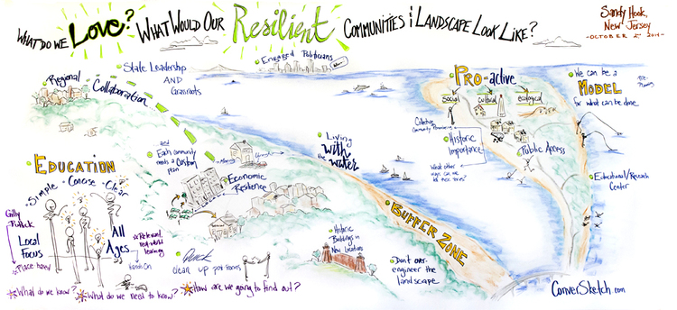
Resilience
  Resilience: “Resilience refers to the capability to prevent or protect against significant multi-hazard threats and incidents and to expeditiously recover and reconstitute critical services with minimum damage to public safety and health, the economy, and national security.” (American Society of Civil Engineers, Critical Infrastructure Definitions, 2006)

Slide 44

Intermediate Solutions
  Social: Networks help increase resiliency
  Economic: Strong economies are more resilient both on an individual and a community basis
  Environmental: Both grey and green infrastructure can be employed to reduce flooding threats

Slide 45
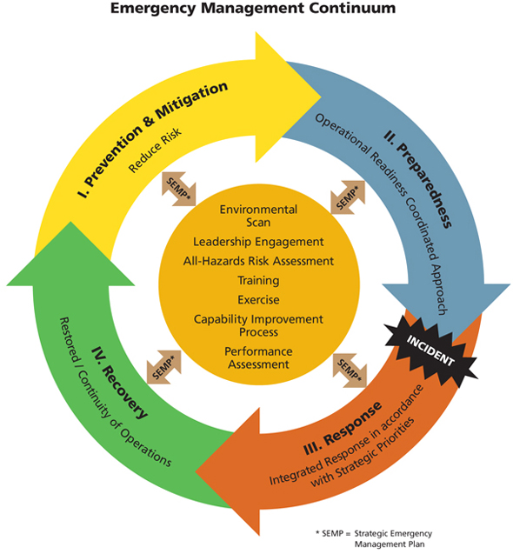
Increasing Social Resiliency
  Make a plan for communicating during a disaster
  Public Education
  Communication
  Access to information
  Strengthening Social networks
  Build a Disaster Kit

Slide 46
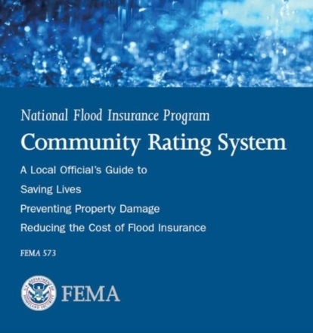

Increasing Economic Resiliency
  Focus on growing economic centers outside of flood prone areas
  Plan for bringing businesses back on line quickly after a disaster
  Participate in programs such as CRS to reduce flood insurance rates and increase individual economic resiliency
  Support initiatives to grow the economy

Slide 47
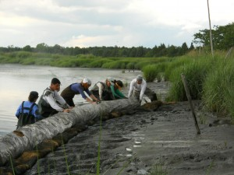

Increasing Environmental Resiliency
  Enforce strict building codes to withstand storm events
  Develop protective infrastructure such as bulkheads/seawalls
  Raise homes, utilities, roads above flood levels
  Build natural storm buffers
  Improve drainage

Slide 48
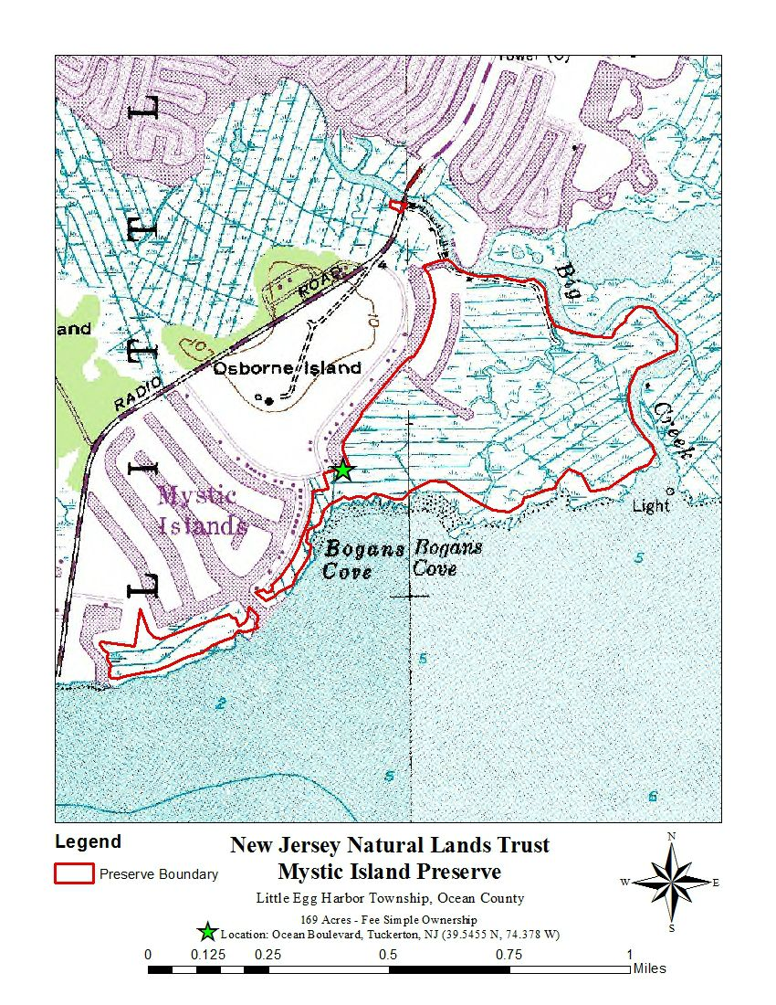
National Fish and Wildlife Funded Project
  Enforce strict building codes to withstand storm events
  $2.13 million received
  Grant covers Tuckerton and Little Egg Harbor
  Includes:
    Dredging
    Thin Layer Deposition
    Living Shoreline construction
    Beach replenishment
    Filling of low lying marsh areas

Slide 49
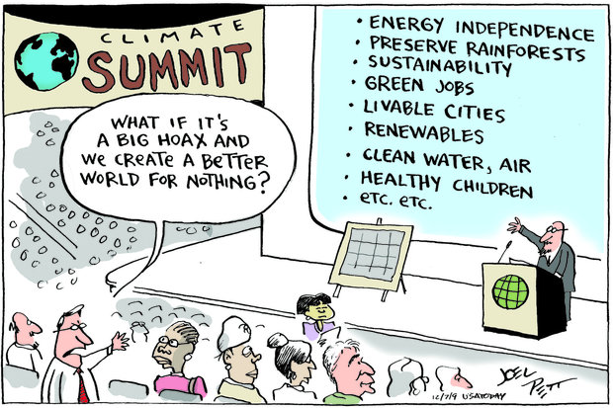

Questions?
Leah Yasenchak: lyasenchak@njfuture.org
David Kutner: dkutner@njfuture.org
www.njfuture.org

Slide 50
Planning For Our Coastal Future
Meeting #1-Vulnerabilty Analysis
4-14-15

